Slide 1
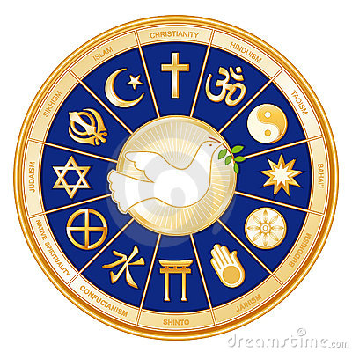
Southern and Eastern Asia RELIGIONS

Slide 2
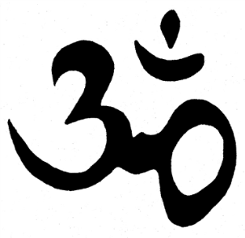
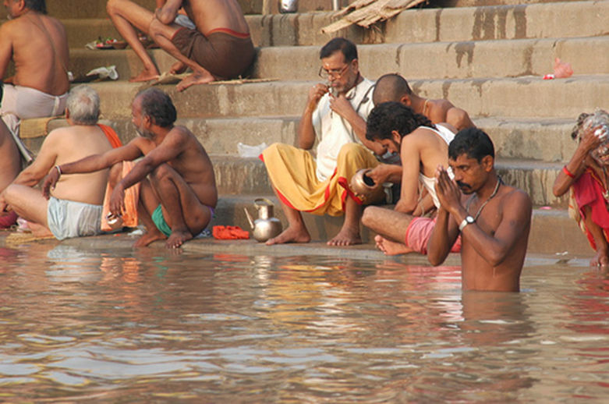
Hinduism
Considered the world’s oldest living religion
Began nearly 4000 years ago near the Indus River
Makes up more than 80% of India’s population (over 900 million followers globally)
Ganges River is considered sacred by Hindus
Has no founder, no single teacher, nor any prophets
Sacred texts called the Vedas

Slide 3
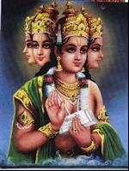
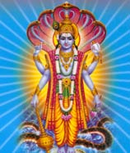
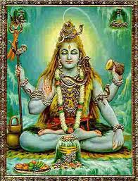
3 Main Gods:
Brahma – the creator
Vishnu – the protector/preserver
Shiva – the destroyer

Slide 4
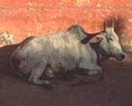
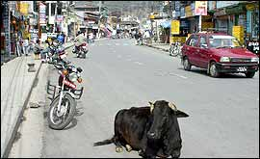
Hindu beliefs
many gods and goddesses, but all are a part of one supreme being – Brahman
all life is holy
Most devout Hindus are vegetarian or vegan, but in particular they will not eat meat from a cow.
Cows, monkeys, elephants, and snakes are sacred.
Sacred cows are allowed to wander wherever they like, even through busy traffic.

Slide 5
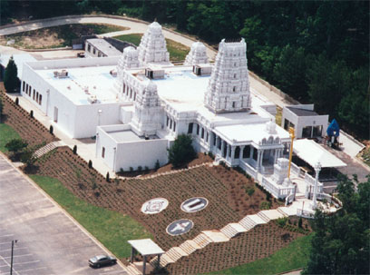
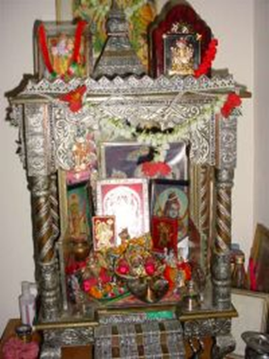
Worship is done individually at temple or at a shrine at home
Families may worship together
Various gods are worshipped depending on needs, day of the week, family tradition, etc.

Slide 6
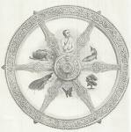
Reincarnation
the idea that after death a person’s soul is reborn into a different body
depending on how a person lived (karma), rebirth may return that person in a higher or lower caste or as an animal
cycle of death, rebirth, life continues until perfection is reached (moksha)

Slide 7
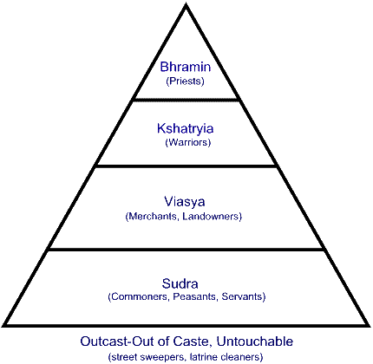
The Caste System
inherited social class
determines job, marriage, friends
less important today
4 main castes:

Slide 8
Hinduism Video
https://cobb.discoveryeducation.com/learn/player/41804ec0-a81e-4bc7-a73d-3e8c78e03584

Slide 9
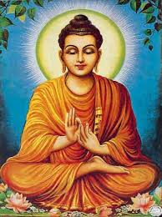
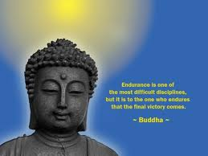
Buddhism
Karma and reincarnation are key beliefs.
Good karma puts one closer to enlightenment while bad karma causes more suffering.
Cycle of reincarnation is broken when one reaches enlightenment, called nirvana.
Buddha is not a god, but a teacher.
Buddhism teaches compassion and tolerance for all living things which is why many Buddhists are vegetarians.
Very peaceful way of life; no wars to be fought in the name of Buddhism
Text: The Tripitaka
Contains the collected teachings of Buddha

Slide 10
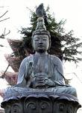
Siddhartha Gautama
Born an Indian prince in 563 B.C. into the warrior caste
Led a life of luxury in his palace
Never suffered or saw other people suffer
One day he saw a sick man, an old man, and a dead man
Bothered him greatly
Lived without any comforts for six years

Slide 11
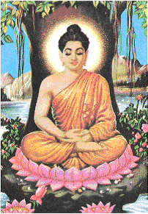
Buddhism…cont’d.
Discovered the truth about life while meditating under a tree
Became known as Buddha, the “enlightened one”
Began to follow the “Middle Way” – a life neither luxurious nor in poverty
Rejected the Hindu caste system and the idea of a supreme being
Spent the rest of his life teaching others how to reach enlightenment

Slide 12
Four Noble Truths
Life is suffering.
The cause of suffering is people’s self-centered desires.
The way to escape suffering is to get rid of self-centered desires.
To get rid of desire, one must follow the Eightfold Path.

Slide 13
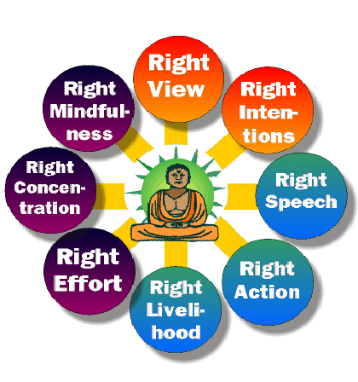
The Eightfold Path
Wisdom
Mental Discipline
Ethical Conduct

Slide 14
Buddhism Video
https://cobb.discoveryeducation.com/learn/player/3093fd0b-ea41-4f51-ae8c-ec6ba90666f1
https://cobb.discoveryeducation.com/learn/player/3093fd0b-ea41-4f51-ae8c-ec6ba90666f1

Slide 15
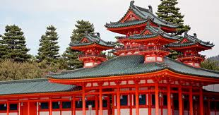
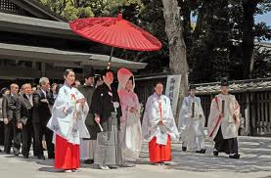
Shintoism
Japanese religion means “way of the gods”
Belief in Kami
supernatural beings that live in all things in nature
extremely close to everyday life
know each person’s needs and guide people’s decisions
No founder and no sacred text
Participation through traditional rites and festivals in the shrines and at home

Slide 16
Shintoism Video
https://cobb.discoveryeducation.com/learn/player/014ba51d-0d14-4aac-b1af-7ccec115e0dc

Slide 17
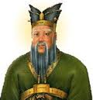
Confucianism
Philosophy of Confucius (born 550 B.C.)
Country of Origin: China
Believed the key to peace was for people to behave with good character and virtue
5 important relationships
ruler and subject
parent and child
husband and wife
older sibling and younger sibling
friend and friend

Slide 18
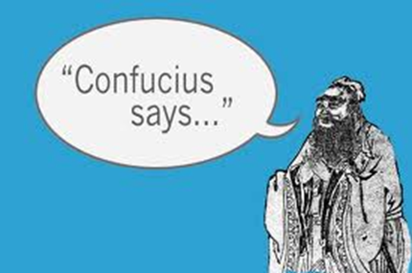
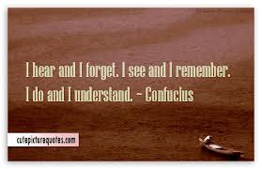
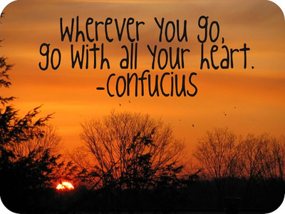
Confucianism
The Four Books & Five Classics
Includes writing of Confucius
Basic Beliefs:
Virtue
Honesty
Love of Family
Kindness to Others
Honest Work
Respect for the State (county/government)

Slide 19
Confucianism Video
https://cobb.discoveryeducation.com/learn/player/cad5a2b4-acb7-47d7-ae1b-ce7226beb383
https://cobb.discoveryeducation.com/learn/player/095293ac-3489-4762-97c9-27ad3191fc17

Slide 20
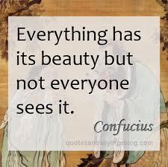
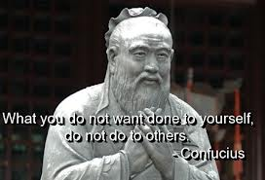

Slide 21
Religion | Country of Origin | Founder | God or gods | Purpose in life | Afterlife | Worship | Sacred texts
Buddhism
Confucianism
Daoism
Hinduism
Islam
Shintoism

Slide 22
Religions of Asia quick quiz
The key to peace is through 5 important relationships.
Monotheistic religion in which the people practice the 5 Pillars.
Japanese religion in which the people believe in Kami.
Religion that makes up over 80% of India’s population.
Belief that one must follow the 4 Noble Truths in order to reach enlightenment.
Yin and yang represent good and evil in nature.
Hinduism
Buddhism
Islam
Shintoism
Confucianism
Daoism

