Slide 1
The Characteristics of Living Things

Slide 2
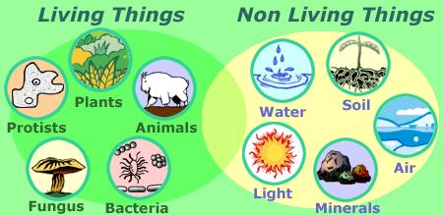
Characteristics of Living Things
What makes something living DIFFERENT from something non-living?
This clip from Sesame Street migh help answer that question…

Slide 3
Characteristics of Living Things
There are actually 7 characteristics that will tell you if something is alive.
We call them “Characteristics of Living Things”
Let’s examine each of them…

Slide 4
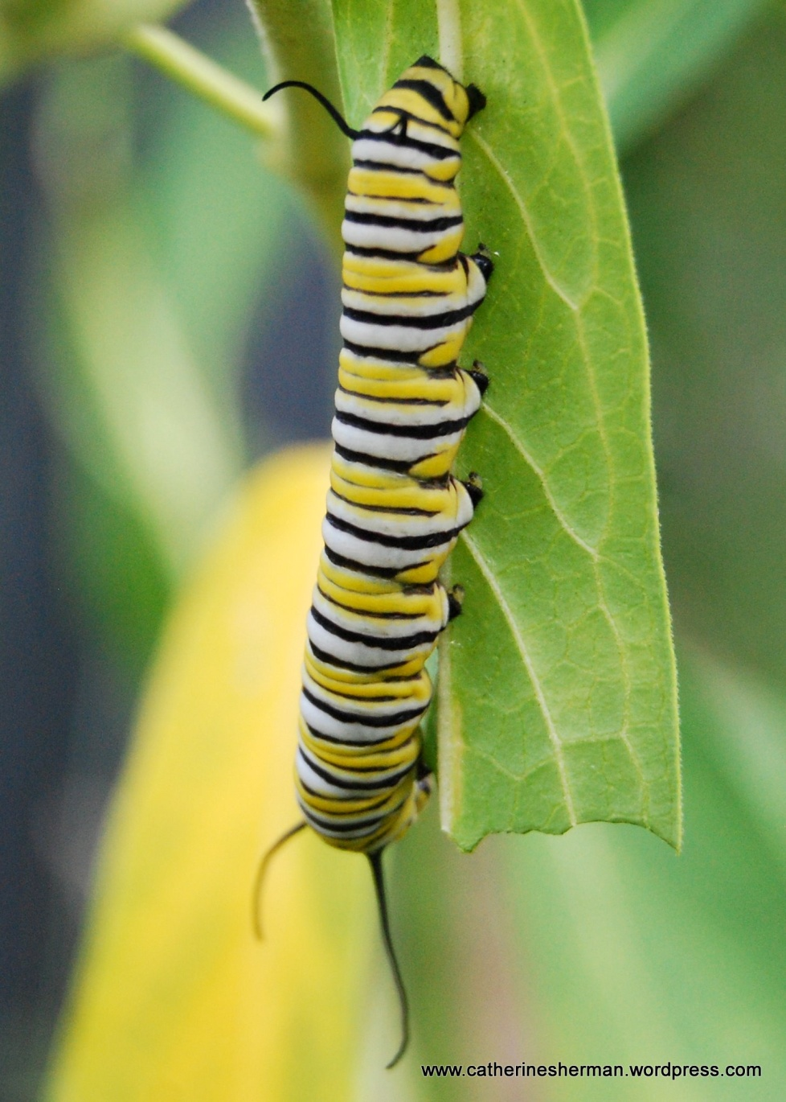
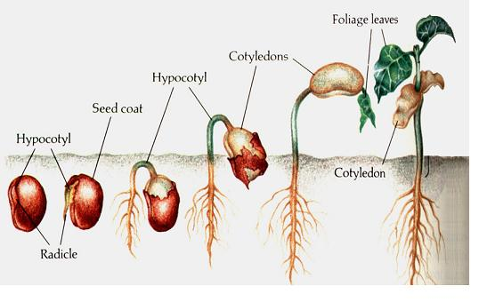
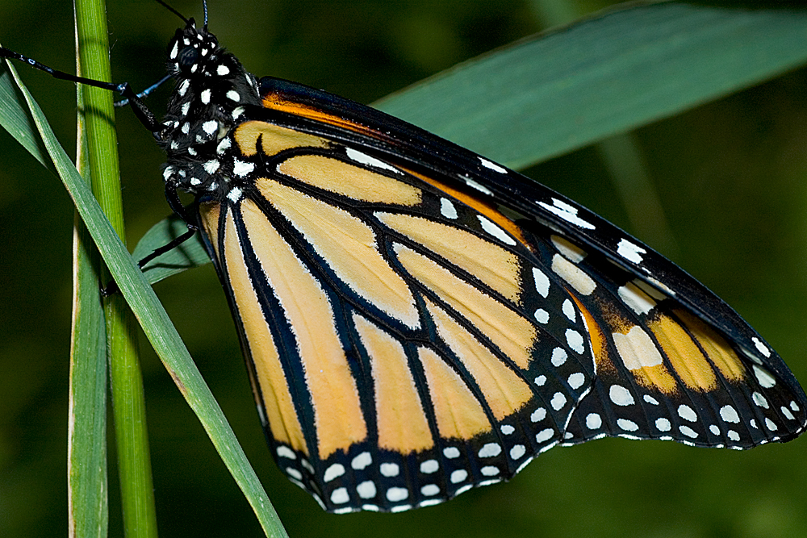
Characteristics of Living Things
1. Living things grow and develop.
Every organism develops at a different rate.
During development, a single cell divides again and again.
After these cells divide they begin to look different from one another and perform different functions.
As a seed grows, different parts of the plant develops.
Butterflies develop from caterpillars during their life cycle.

Slide 5
An icicle can grow, but why isn’t it alive?
Notes:
Answer: icicles grow, but cannot reproduce or eat

Slide 6
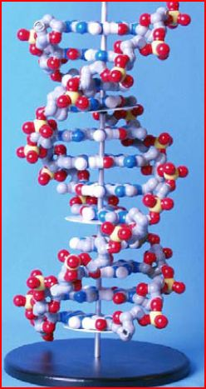
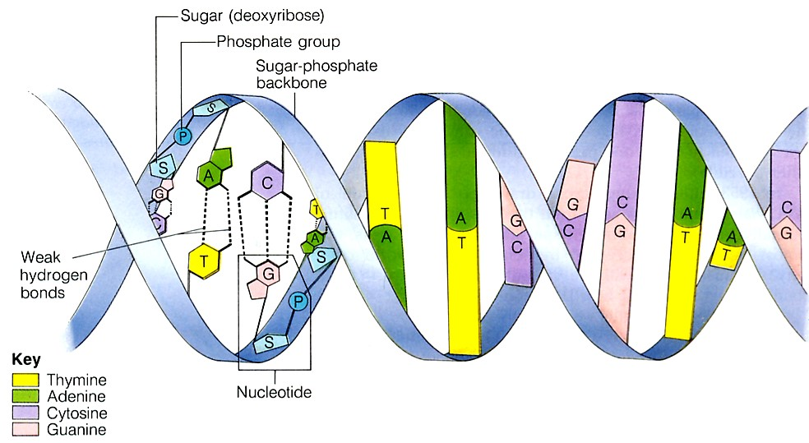
Characteristics of Living Things
2. Living things are based on a universal genetic code.
All organisms store information they need to live, grow, and reproduce in a genetic code written in a molecule called DNA.

Slide 7
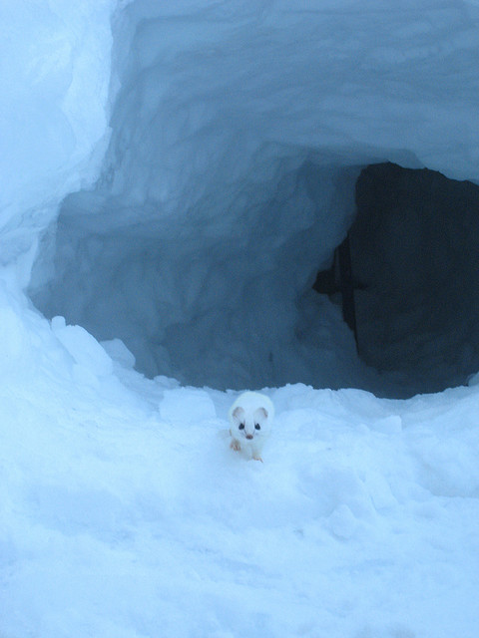
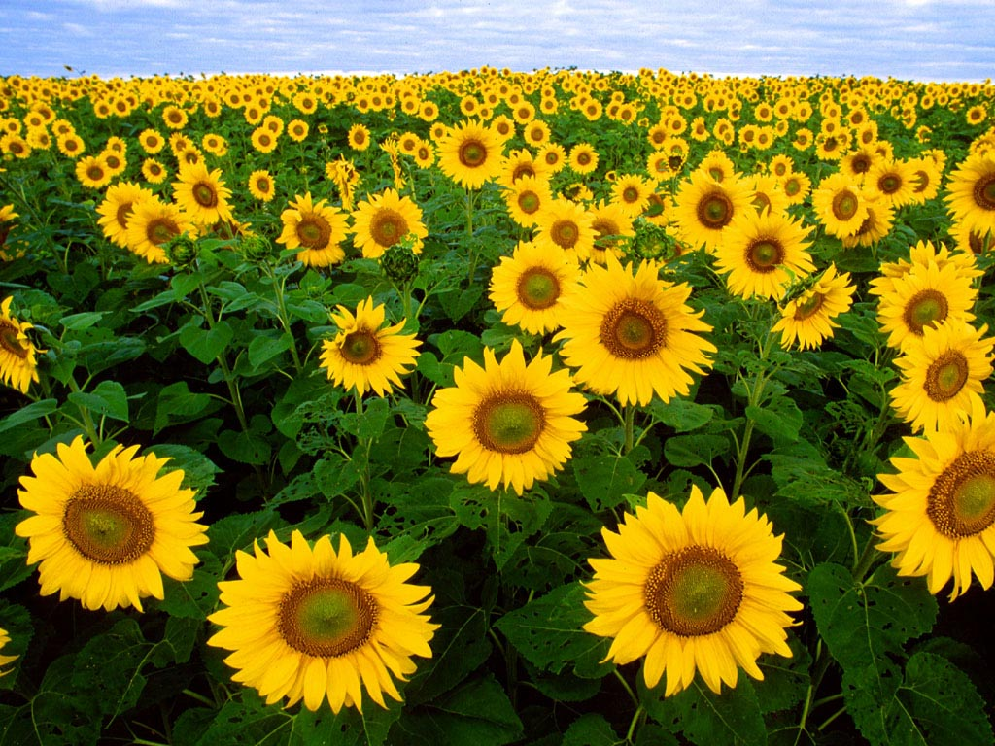
Characteristics of Living Things
3. Living things respond to their environment.
Organisms detect and respond to signals from their environment
For example, plants respond to light by growing
Mammals respond to cold temperature by growing thicker fur.

Slide 8
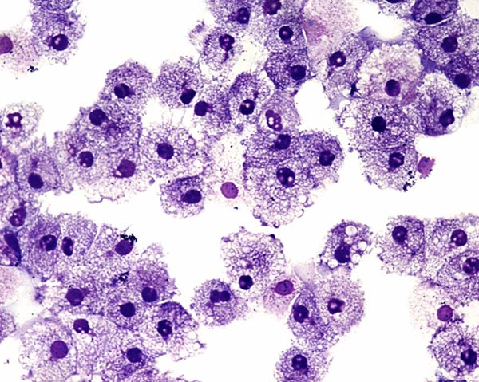
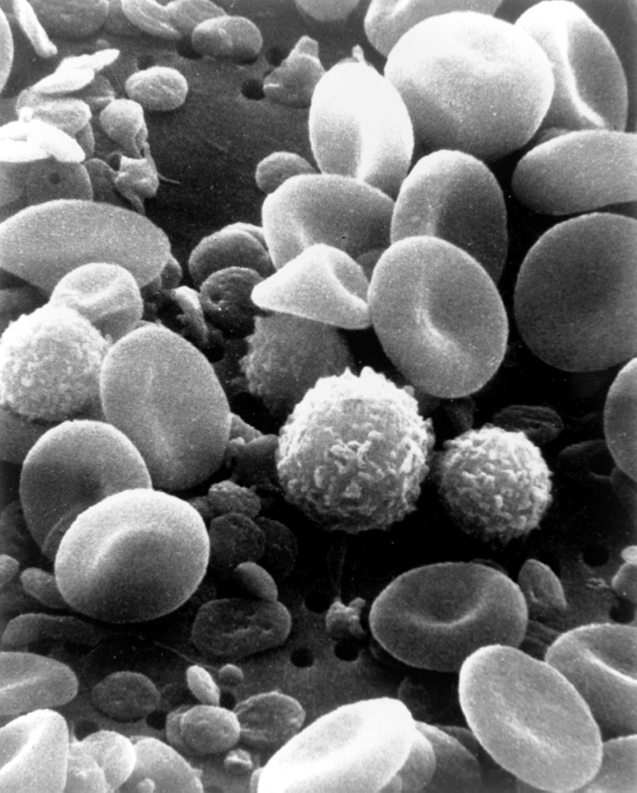
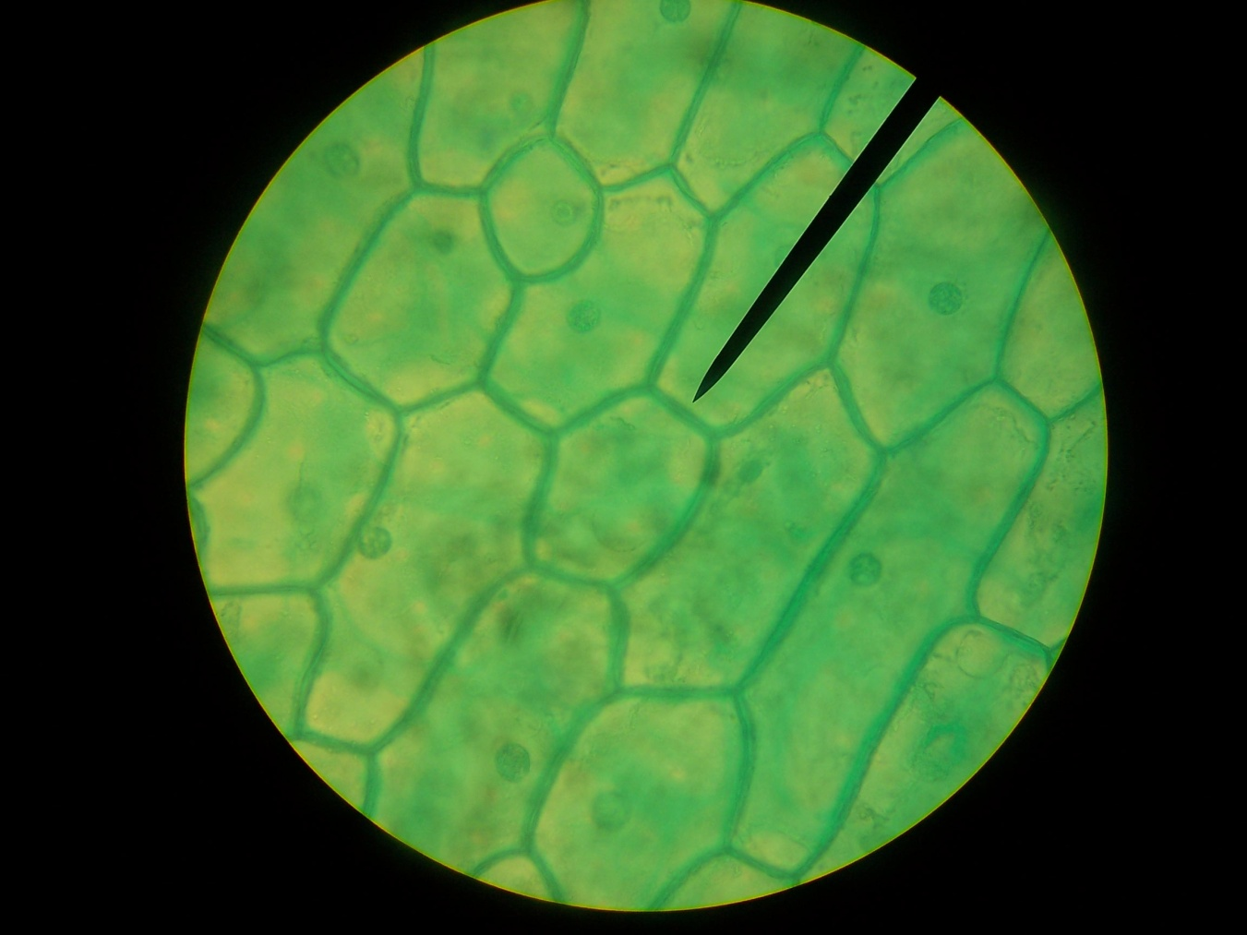
Characteristics of Living Things
4. Living things are made up of cells.
Organisms are composed of one or more cells.
Cells are the smallest living things.
Cells are complex and very organized.
Blood cells
Human cheek cells
Plant leaf cells

Slide 9
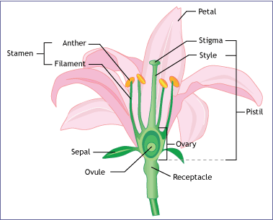
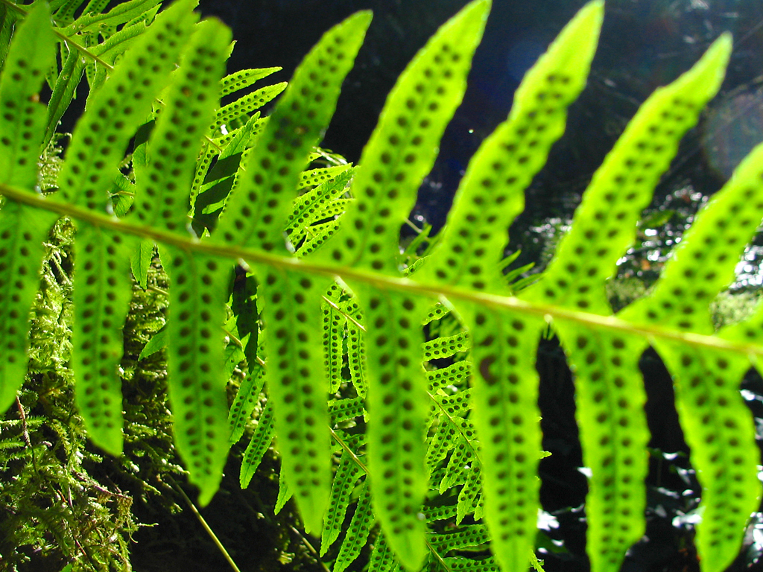
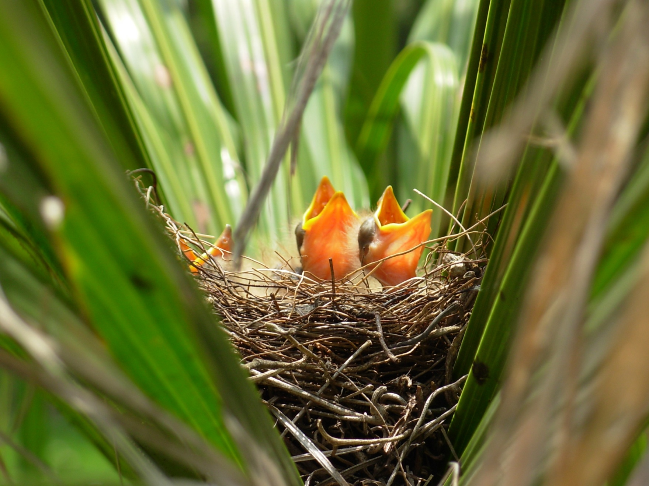
Characteristics of Living Things
5. Living things reproduce.
All organisms reproduce, which means that they produce new similar organisms.
Some organisms have two parents (sexual reproduction) and others have just one (asexual reproduction)
Birds have two parents, so these chicks were produced through sexual reproduction
This fern has produced spores by dividing its own leaf cells. A fern uses asexual reproduction
This flower has male and female sex cells, so it is using sexual reproduction

Slide 10
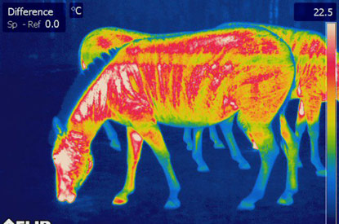
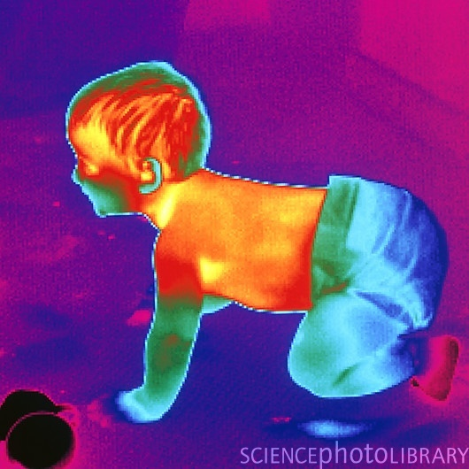
Characteristics of Living Things
6. Living things maintain a stable internal environment.
All organisms need to keep their internal environment relatively stable, even when external conditions change dramatically.
This is called HOMEOSTASIS
Thermal images show that even though the temperature outside the body is cool, inside there is warm and stable environment.

Slide 11
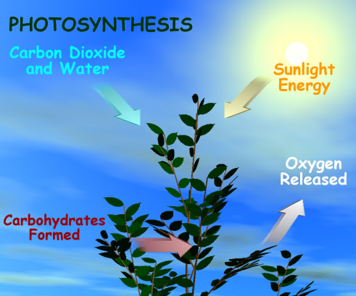
Characteristics of Living Things
7. Living things obtain and use material and energy.
All organisms must take in materials and energy to grow, develop, and reproduce.
Chemical reactions breaks down materials in what is called METABOLISM.

Slide 12
You can take any living organism and apply all seven characteristics…

Slide 13
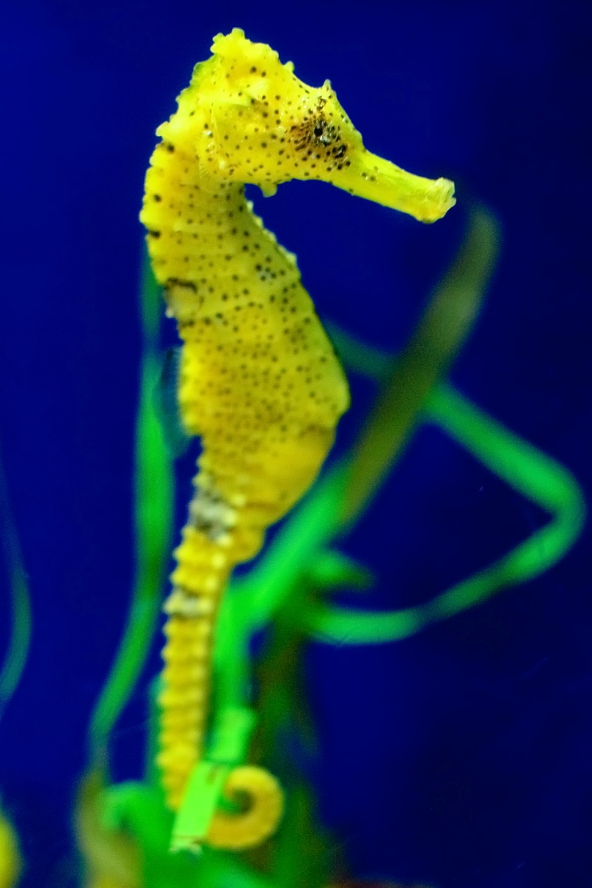
Example: Pigmy Seahorse
1. Living things grow and develop:
Most seahorses reach the age of reproduction at about 100 days old.

Slide 14
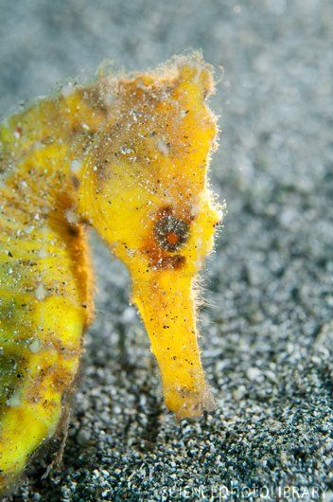
Example: Pigmy Seahorse
2. Living things are based on a universal genetic code (DNA):
The Pigmy seahorse has 48 chromosomes

Slide 15
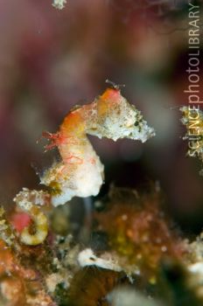
Example: Pigmy Seahorse
3. Living things respond to their environment:
Seahorses can adapt to a variety of water temperatures.
They can only reproduce when the water is 20-28 degrees C.
When light intensity is too bright or too dim birth defects can occur in the babies.

Slide 16
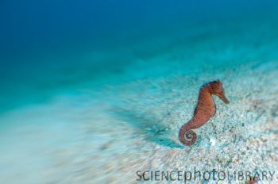
Example: Pigmy Seahorse
4. Living things are made up of cells:
Seahorses have fewer cells than other ocean-dwelling animals.
All of the cells of the species Hippocampus trimacutus can fit inside it’s 3 cm length body.

Slide 17
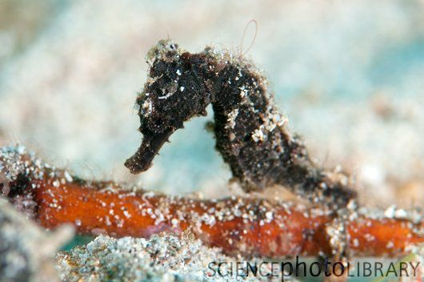
Example: Pigmy Seahorse
5. Living things reproduce:
Mature seahorses can reproduce 10-12 times each year.
Female seahorses will release several hundred eggs at a time.

Slide 18
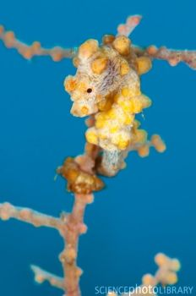
Example: Pigmy Seahorse
6. Living things maintain a stable internal environment:
Seahorses are cold blooded, so their internal environment depends on the temperature of the water they are in.
They survive best in water that is 28 ˚C on average.

Slide 19
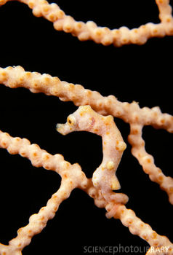
Example: Pigmy Seahorse
7. Living things obtain and use material and energy
Seahorses eat the larvae of small crustaceans.
This food provides the energy for seahorses to live.

Slide 20
Characteristics of Living Things
Let’s Summarize:
Living things…
Grow and Develop
Are based on a universal genetic code
Respond to their environment
Are made of cells
Reproduce
Maintain a stable internal environment
Obtain and use material and energy

Slide 21
Reference:
http://www.fao.org/docrep/field/003/AB736E/AB736E01.htm

