Slide 1
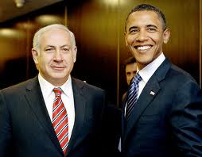
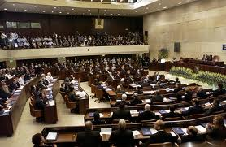
Israel
Parliamentary Democracy
Prime Minister and Parliament are elected by the people (exception to the rule)
Parliament is known as Knesset (120 members, 4 yr. terms)
Coalition government of many parties.
Prime Minister is Benjamin Netanyahu
President (Reuven Rivlin) is a ceremonial role, not part of three branches
Major issue is security.
All citizens can vote and speak freely.

Slide 2
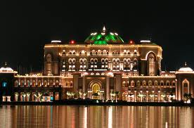
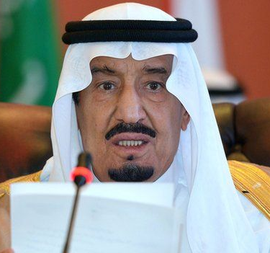
Saudi Arabia
Government Type:
Islamic (Theocracy) absolute/autocratic monarchy (Al-Saud dynasty)
Leader:
King Salman inherited throne in Jan. 2015 when half-brother, King Abdullah, died (who had ruled since 2005).
The King of Saudi Arabia is both chief of state and the head of government
Voting:
No political parties and no national elections
Cabinet is appointed by king (many are royal family members)
Citizens (Women – first voted in 2015) elect local council members
Other:
The king inherits his position
Qur’an is the constitution of the country, which is governed on the basis of Islamic law (Shari’a).

Slide 3
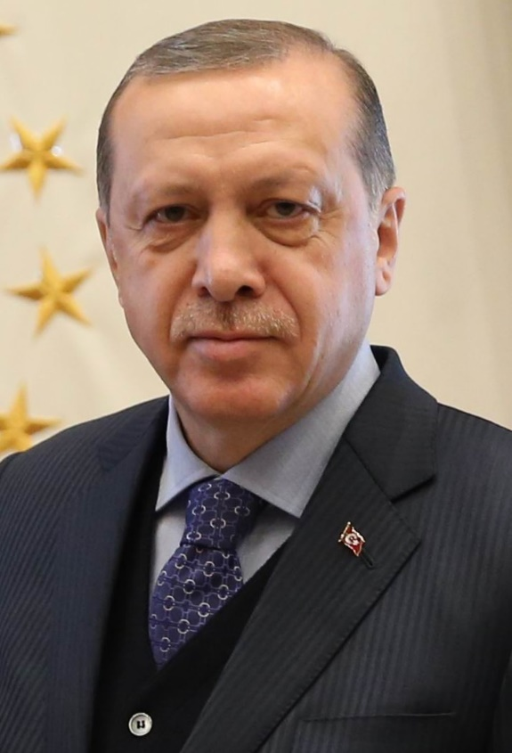
Turkey-
Government Type:
Presidential Democracy
Leader:
Head of Government: President Recep Erdogan (2014) (Took more powers than he was supposed to, and citizens voted in April 2017 to grant sweeping powers to the President.) – re-elected again in June 2018
Voting:
Universal voting rights
Other:
Has limited freedom of speech
Arrests of journalists, changed Turkey’s constitution
Survived a coup in 2016
Accusations of corrupt elections
Unicameral legislature – Parliament
Grand National Assembly of Turkey
600 directly-elected representatives

Slide 4
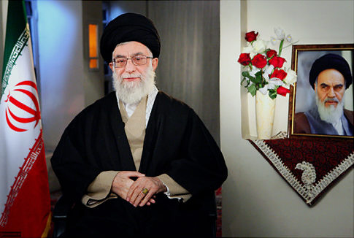
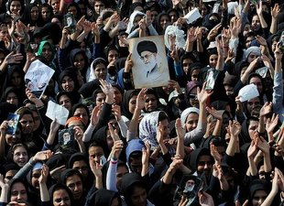
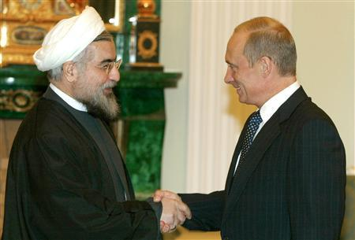
Iran
Government Type:
Theocratic Republic (Islamic)
Leader:
Ayatollah Ali Khamenei is the Head of Government(1989-present)
Religious leader – theocracy
Ayatollah means “Supreme Leader” according to Qur’an
Appointed by special committee for life
Chief of State: President Hasan Ruhani
Voting:
Election of president in June 2013
Citizens 18 and over can vote.

Slide 5
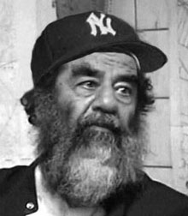
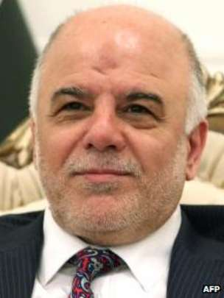
Iraq
Government Type:
Parliamentary Government
Leader:
Head of Government: Prime Minister – Adil Abdul-Mahdi
Chief of State: President Barham Salih
Voting:
18 universal voting rights
Other:
Saddam Hussein (former dictator)was captured (2003) by U.S. and tried by the Iraqi government.
2010 open and free elections
U.S. has sponsored elections but split between Sunni, Shia, and Kurds has made free elections difficult.
Violence continues to disrupt stability
U.S. soldiers are still there fighting ISIS

Slide 6
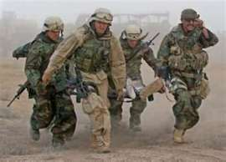
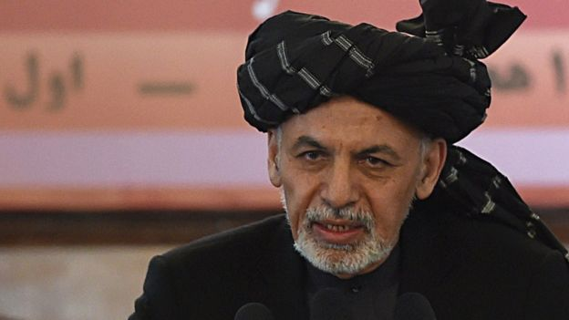
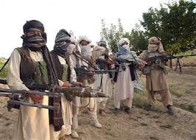
Afghanistan
Government Type:
Theocracy and democracy
Islamic Presidential Democracy
Leader:
President Ashraf Ghani
President sworn in in September 2014 following months of bitter argument over who won the election
Voting:
18 universal
Other:
United States’ goal: stabilize and bring democracy.
Constitution set in 2004 with help of N.A.T.O.
Taliban still controls parts of Afghanistan
Democracy has been slow to grow because of fear and influence of Taliban
Oct. 2015 – President Obama announced plan to keep 5,500 troops there indefinitely
Had pledged to get all troops out

Slide 7
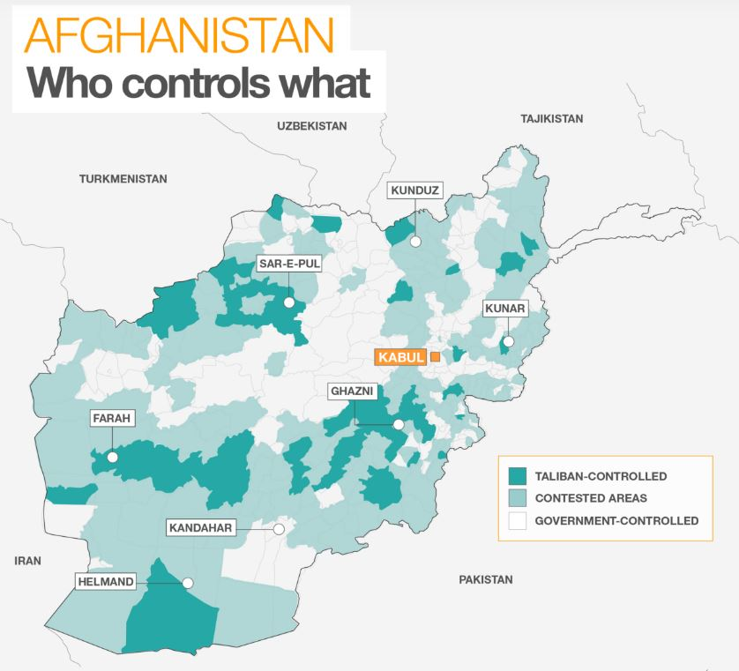
Afghanistan

