Slide 1
Southwest Asia Today
Dubai, UAE

Slide 2
SS7E4 Analyze different economic systems.
a. Compare how traditional, command, and market economies answer the economic questions of 1-what to produce, 2-how to produce, and 3-for whom to produce.
b. Explain that countries have a mixed economic system located on a continuum between pure market and pure command.
c. Compare and contrast the economic systems in Israel, Saudi Arabia, and Turkey.
SS7E5 Explain how voluntary trade benefits buyers and sellers in Southwest Asia (Middle East).
a. Explain how specialization encourages trade between countries.
b. Compare and contrast different types of trade barriers, such as tariffs, quotas, and embargoes.
c. Explain why international trade requires a system for exchanging currencies between nations.
d. Explain the primary function of the Organization of Petroleum Exporting Countries (OPEC).
SS7E6 Describe factors that influence economic growth and examine their presence or absence in Israel, Saudi Arabia, and Turkey.
a. Evaluate how literacy rates affect the standard of living.
b. Explain the relationship between investment in human capital (education and training) and gross domestic product (GDP per capita).
c. Explain the relationship between investment in capital goods (factories, machinery, and technology) and gross domestic product (GDP per capita).
d. Explain how the distribution of oil has affected the development of Southwest Asia (Middle East).
e. Describe the role of entrepreneurship.

Slide 3
Standard of Living vs. Literacy Rate & GDP per capita
Literacy Rate – percentage of the population at a specific age that can read and write
GDP per capita – GDP based on population
Standard of Living – the degree of wealth and material comfort available to the general population of a country.
GDP – total value of all goods and services (Gross Domestic Product)
Are literacy rate and GDP linked to standard of living?

Slide 4
High Standards of Living vs. Low Standards of Living
Israel
Population-8,424,904 Literacy rate – 97.8%
GDP per capita - $36,400
GDP: $317.1 billion
Manufacturing, technology
Saudi Arabia
Population – 33,091,113
Literacy rate – 94.7%
GDP per capita - $54,500
GDP - $1.775 trillion
Oil production
Afghanistan
Population – 34,940,837
Literacy rate – 38.2%
GDP per capita - $2,000
GDP: $20.24 billion
Services, wheat, fruits, small-scale manufacturing
Turkey
Population – 81,257,239
Literacy rate – 96.2%
GDP per capita - $27,000
GDP: $2.186 trillion
Services, textiles

Slide 5
Other Standards of Living
United States
Population: 329,256,465
Literacy Rate – 99%
GDP per capita - $59, 800
GDP: $19.49 trillion

Slide 6
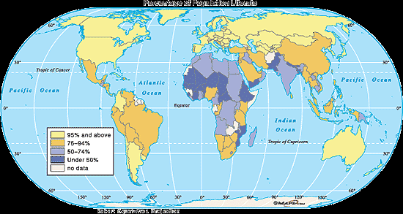
World Literacy Map

Slide 7
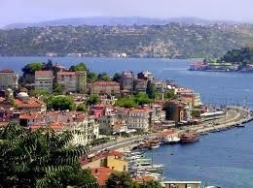
The Eastern Mediterranean
Includes Turkey*, Jordan, Israel*, Lebanon, Syria, and Palestinian territories
Faced many conflicts
Struggle to achieve peace
Camp David Accords
Not much oil but they do have areas with mild climates and fertile lands
Farming is important

Slide 8
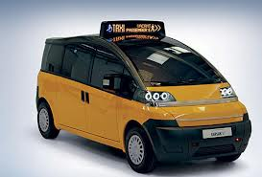
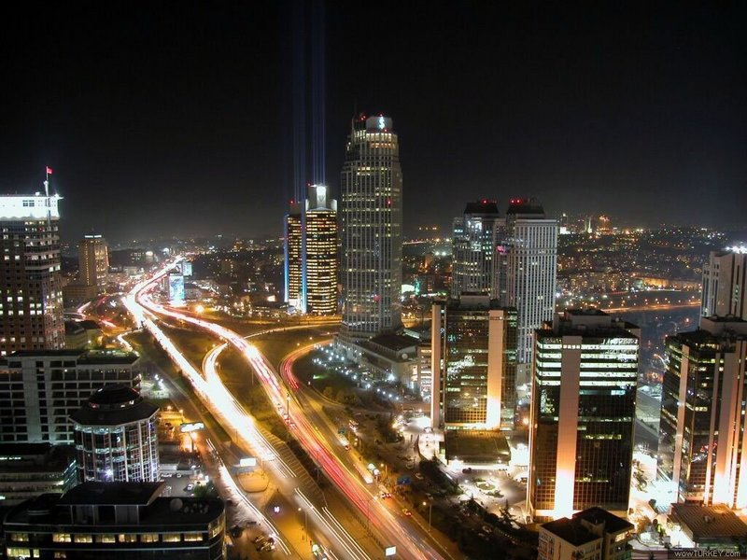
Turkey
Mild Mediterranean climate (cooler, gets rain)
One of the largest populations in SWA
(81,257,239)
Agriculture for local use
Exports cotton and tobacco
Produces textiles, steel, and cars
Gradually moved from gov’t-directed economy to more private enterprise

Slide 9
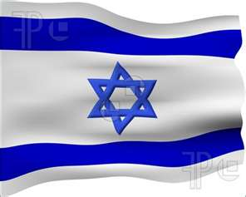
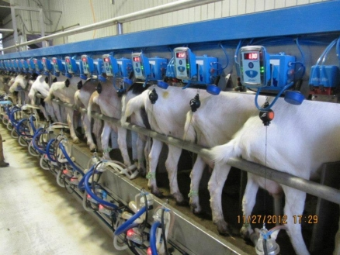
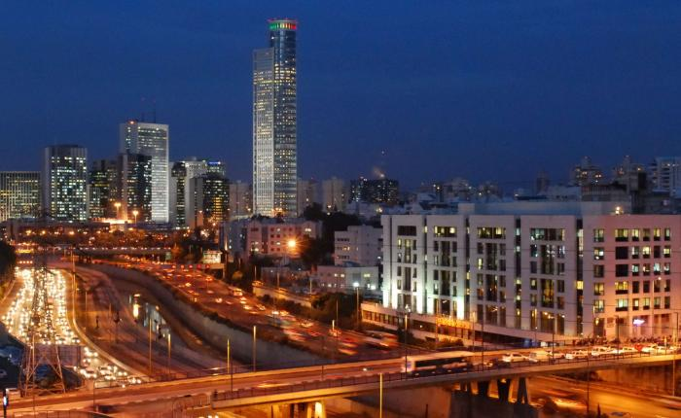
Israel
Highly developed and industrial economy
High tech manufacturing (aviation, computers), wood and paper products, timber, and agriculture
Government owns many businesses and land but is gradually privatizing companies
moving from command toward market

Slide 10
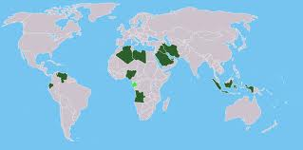
Arabian Peninsula
Saudi Arabia*, Yemen, UAE, Oman, Qatar, Bahrain
Oil exports support economies
Oil discovered in 1930’s
Major suppliers of the world’s energy
Petrochemicals
products made from petroleum and natural gas
plastics, cosmetics, detergents, fertilizers, etc.
OPEC
Organization of the Petroleum Exporting Countries
Decides how much oil to produce and the price
15 member nations around the world

Slide 11
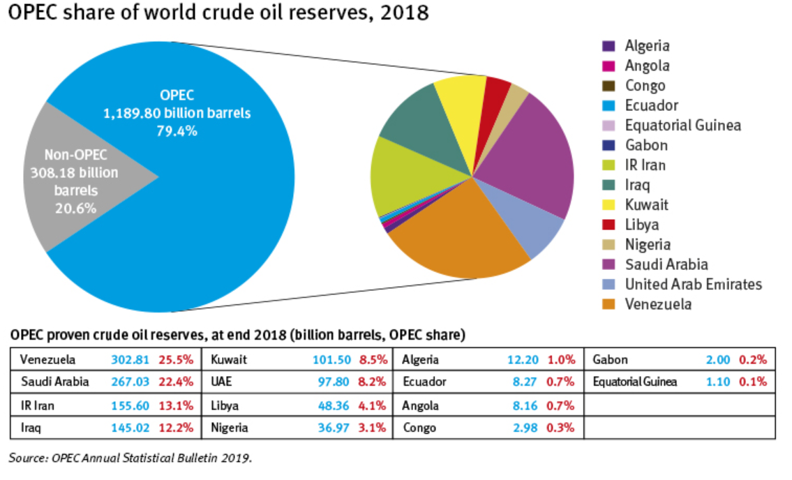

Slide 12
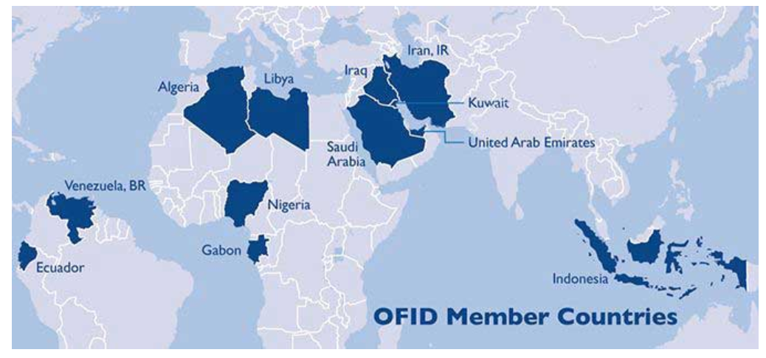

Slide 13
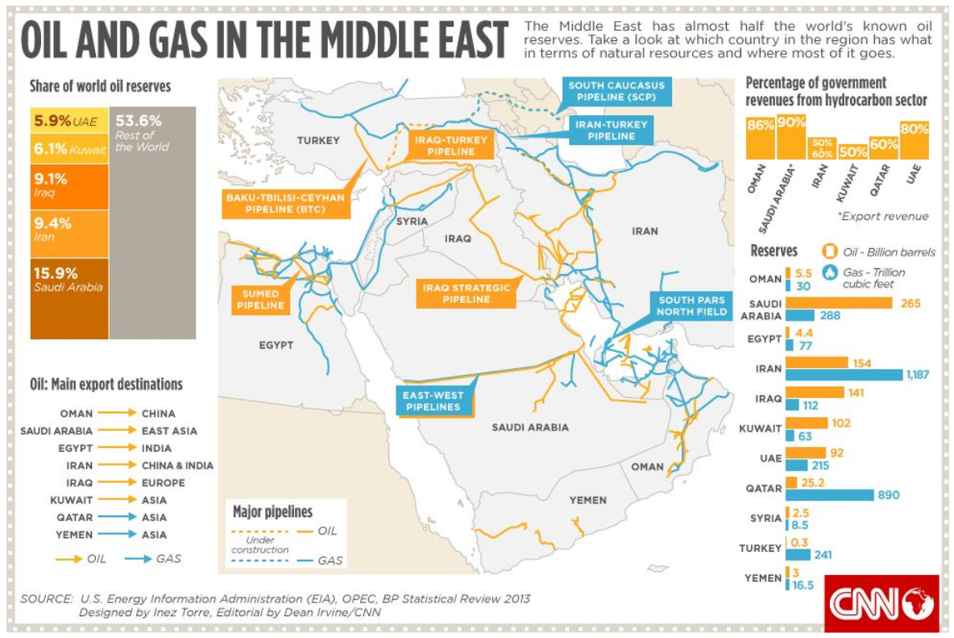

Slide 14
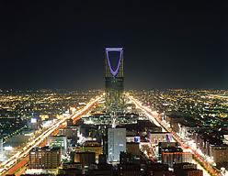
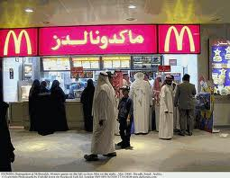
Saudi Arabia
World’s second leading producer of oil
Schools, hospitals, roads, and airports built with oil income
Building new industries to diversify economy
Most of oil industry operated by government
Relies on specialized labor from other countries
Gov’t trying to increase private ownership of business

Slide 15
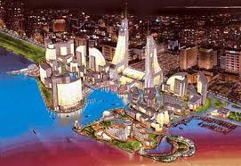
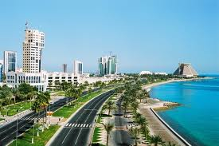
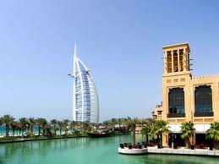
The Persian Gulf Countries
Includes Kuwait, Bahrain, Qatar, and the United Arab Emirates (UAE)
Profits from oil exports used to build strong, wealthy economies
Education, health care, and other services provided to citizens for free
Diversifying economy in case oil runs out

Slide 16
Diversification (from www.strategyand.pwc.com)
An economy that depends on a variety of goods and services for income (instead of just one)
Purpose: To make a country’s economy sustainable (long-lasting)
In the Middle East:
Too many countries’ economies depend only on oil, and oil is a non-renewable resource. It will eventually run out.
Possible Ways to Diversify:
Tourism, Clothing, Agriculture, Manufacturing

Slide 17
Trade & Specialization
Voluntary trade helps each country
Remember: Saudi Arabia has a lot of oil, but it cannot easily grow food. The US has fertile plains for growing food, but it’s more expensive for the US to extract its own oil.
SPECIALIZATION LEADS TO TRADE
Sometimes countries use trade barriers (quota, tariff, embargo) to help their own interests.
Punish another country
Protect an industry within the country
Usually are detrimental to both countries involved

Slide 19
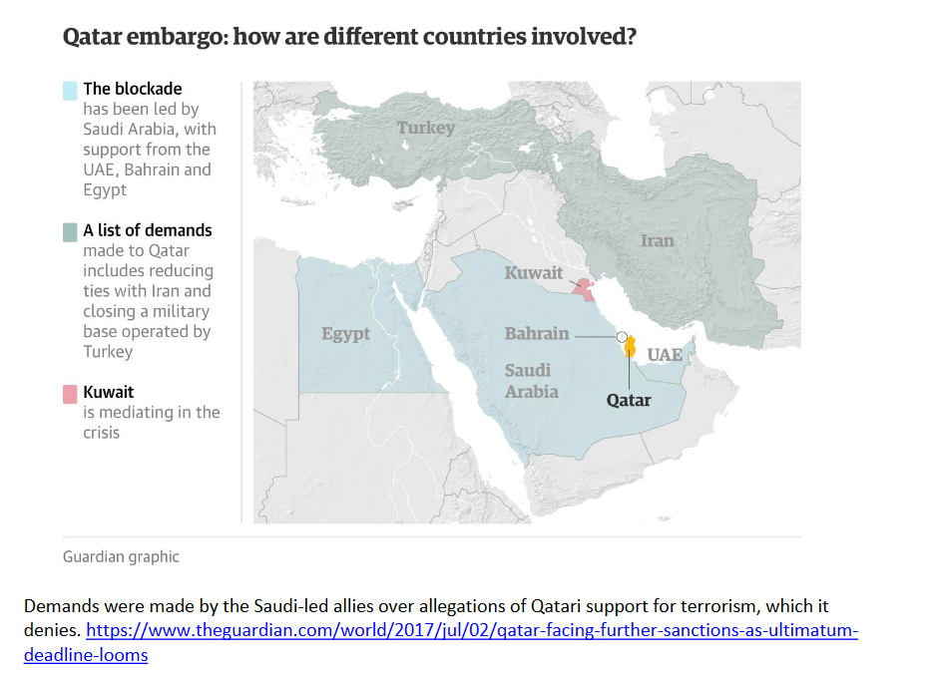

Slide 20
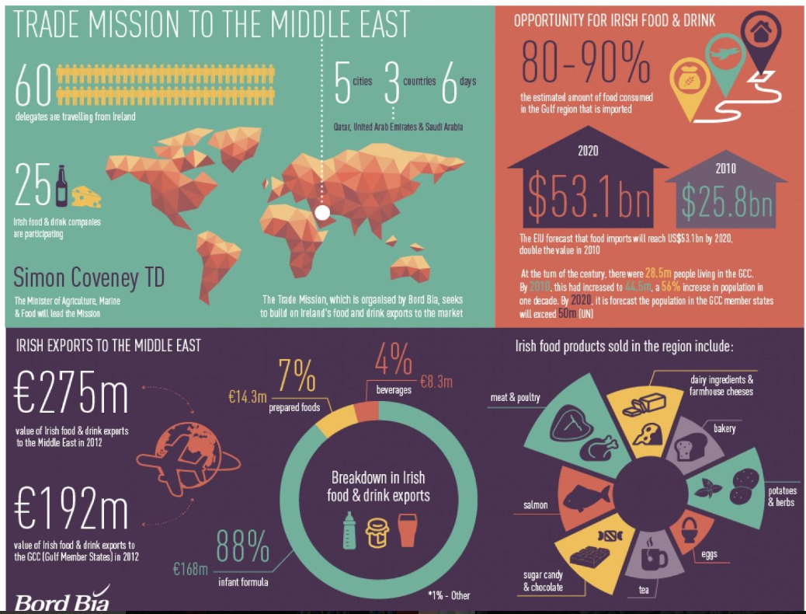
a

Slide 21
Economic continuum
Command
SA T
I
Market
•
SA = Saudi Arabia – 60.7
T = Turkey – 64.6
I = Israel – 72.8
US = 76.8

Slide 22
Assessment
Total value of goods and services sold in a country
Organization which keeps oil prices high for the world
Eastern Mediterranean nation that produces textiles, steel, and cars
Nation that produces high tech manufacturing (aviation, computers), financial services, timber, and agriculture
% of people over 15 who can read and write
When an economy depends on a variety of goods and services for income in an effort to be long-lasting
World’s largest oil producer
Literacy Rate
GDP
Diversification
OPEC
Turkey
Saudi Arabia
Israel

Slide 23
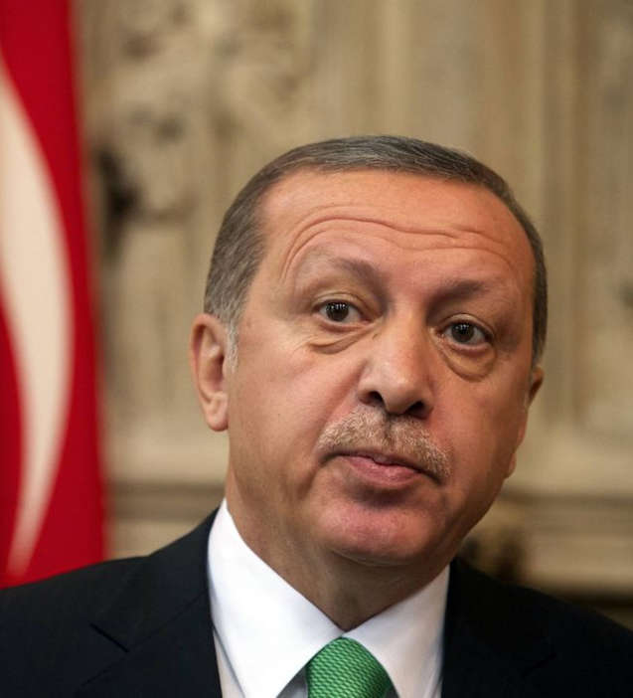
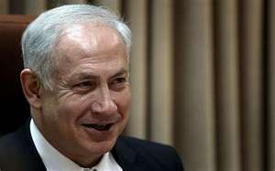
Governments of Middle East
Let’s review the different types of governments
Absolute/Autocratic Monarchy
Dictatorship
Autocracy
Oligarchy
Democracy
Parliamentary
Presidential
Theocracy
King Salman (SA)
President Erdogan (T)
Benjamin Netanyahu (Is.)

Slide 24
SS7CG3 Compare and contrast various forms of government.
a. Explain citizen participation in autocratic and democratic governments [i.e., the role of citizens in choosing the leaders of Israel (parliamentary democracy), Saudi Arabia (autocratic monarchy), and Turkey (parliamentary democracy)].
b. Describe the two predominant forms of democratic governments: parliamentary and presidential.

Slide 25
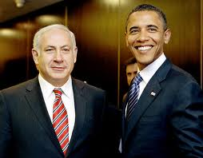
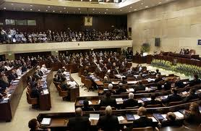
Israel
Parliamentary Democracy
Prime Minister and Parliament are elected by the people (exception to the rule)
Parliament is known as Knesset (120 members, 4 yr. terms)
Coalition government of many parties.
Prime Minister is Benjamin Netanyahu
President (Reuven Rivlin) is a ceremonial role, not part of three branches
Major issue is security.
All citizens can vote and speak freely.

Slide 26
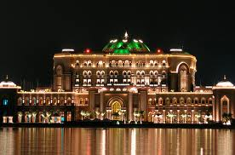
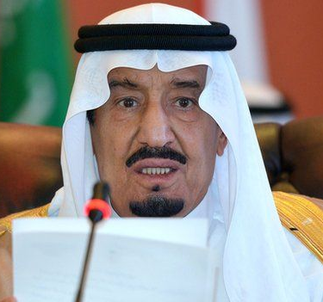
Saudi Arabia
Islamic absolute/autocratic monarchy (Al-Saud dynasty)
The king inherits his position
Qur’an is the constitution of the country, which is governed on the basis of Islamic law (Shari’a).
No political parties and no national elections
Cabinet is appointed by king (many are royal family members)
Citizens (Women – first voted in 2015) elect local council members.
The King of Saudi Arabia is both chief of state and the head of government
King Salman inherited throne in Jan. 2015 when half-brother, King Abdullah, died (who had ruled since 2005).
http://www.bbc.com/news/world-middle-east-14703478

Slide 27
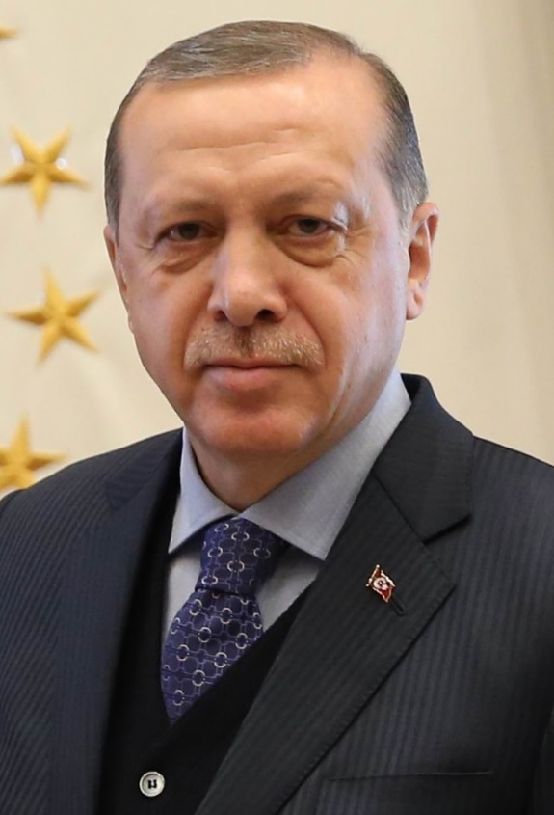
Turkey-
Parliamentary Democracy-transitioned to a presidential democracy
Unicameral legislature – Parliament
Grand National Assembly of Turkey
600 directly-elected representatives
Head of Government: President elected by people for five-year term
President Recep Erdogan (2014) (Took more powers than he was supposed to, and citizens voted in April 2017 to grant sweeping powers to the President.) – re-elected again in June 2018
Has limited freedom of speech – arrests of journalists, changed Turkey’s constitution
Survived a coup in 2016
Accusations of corrupt elections
Universal voting rights

Slide 28
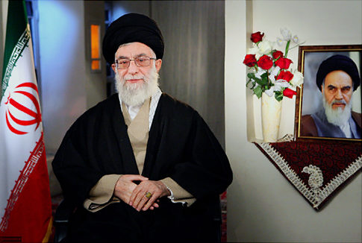
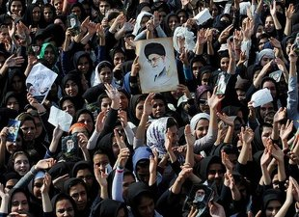
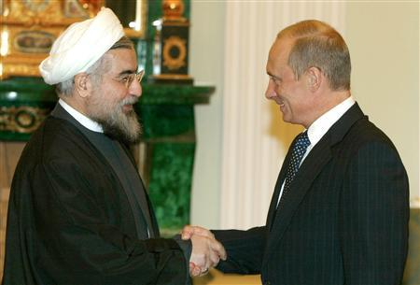
Iran
Ayatollah Ali Khamenei is the Head of Government(1989-present)
Religious leader – theocracy
“Supreme Leader” according to Qur’an
Appointed by special committee for life
Election of president in June 2013
Citizens 18 and over can vote.
President Hasan Ruhani:
“My government will be one of prudence and hope and my message is about saving the economy, reviving ethics and interaction with the world.”

Slide 29
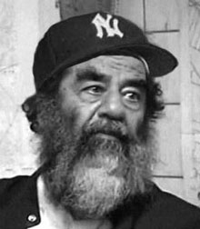
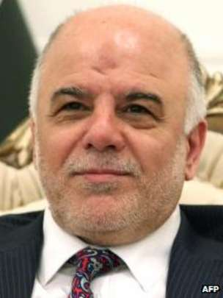
Iraq
Parliamentary Government
Prime Minister – Adil Abdul-Mahdi (term began in October 2018. Vice president from 2005-2011)
President: Barham Salih
Voting: 18 universal
U.S. has sponsored elections but split between Sunni, Shia, and Kurds has made free elections difficult.
2010 open and free elections
Saddam Hussein (former dictator)was captured (2003) by U.S. and tried by the Iraqi government.
U.S. soldiers are still there fighting ISIS
Violence continues to disrupt stability
http://www.bbc.com/news/world-middle-east-14544543

Slide 30
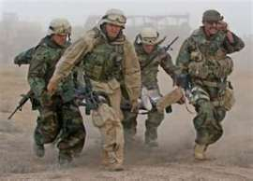
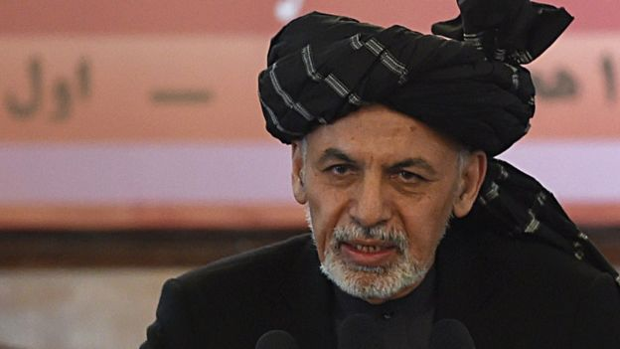
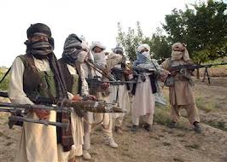
Afghanistan
Theocracy and presidential democracy
United States’ goal: stabilize and bring democracy.
Constitution set in 2004 with help of N.A.T.O.
Ashraf Ghani
President sworn in in September 2014 following months of bitter argument over who won the election
He replaced Hamid Karzai, who led the country for twelve years after the Taliban were overthrown in 2001.
Taliban still controls parts of Afghanistan
Voting: 18 universal
Democracy has been slow to grow because of fear and influence of Taliban
https://www.washingtonpost.com/politics/obama-and-pakistani-leader-focus-on-peace-talks-in-afghanistan/2015/10/22/2afff154-78bc-11e5-a958-d889faf561dc_story.html
http://www.bbc.com/news/world-south-asia-12011352

Slide 31
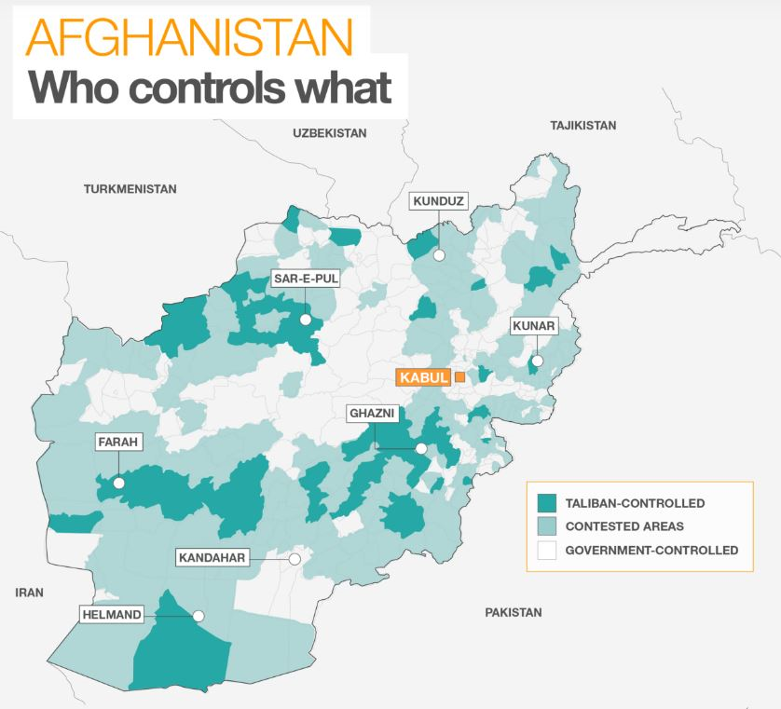

Slide 32
Assessment
8. Israel
9. Iran
10. Saudi Arabia
Parliamentary Democracy
Islamic Absolute Monarchy
Theocracy (Islamic Republic)
Ayatollah Khamenei
Prime Minister Benjamin Netanyahu
King Salman

