Slide 1
Respiratory System
By: Morgan J, Serena D, Elizabeth E.

Slide 2
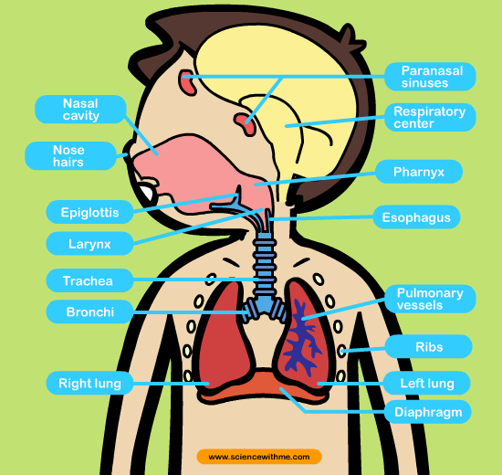
General Physician Respiratory System
The major roles are ……
-Respiratory provides oxygen to the body’s cells while removing carbon dioxide. The three major parts are the airway, lungs, and the muscles of respiration.
-The airway which includes the nose, mouth, pharynx, larynx, trachea, bronchi, and bronchioles, carries air between the lungs and the body’s exterior.
-The lungs act as the functional units of the respiratory system by passing oxygen into the body and carbon dioxide out of the body.
-The muscles of respiration including the diaphragm and intercostal muscles, work together to act as a pump, pushing air into and out of the lungs during breathing.
Respiratory System Vocabulary
Respiratory System: a collection of organs whose main function is to take in oxygen and eject carbon dioxide, which includes lungs, throat, and passages ways that lead to the lungs.
Respiration: in biology, the exchange of oxygen and carbon dioxide between living cells and their environment which includes, breathing and cellular respiration.
Pharynx: in flat worms, the muscular tube that leads from the mouth to the gastrovascular cavity; in animals with a digestive tract, the passage from the mouth to the larynx and esophagus.
Larynx: the area of the throat that contains the vocal chords and produces vocal sounds.
Trachea: in insects, myriapods, and spiders, one of a network of air tubes; in vertebrates, the tube that connects the larynx to the lungs.
Bronchus: one of the two tubes that connect the lungs with the trachea.
Alveolus: any of the tiny air sacs of the lungs where oxygen and carbon dioxide are exchanged
In humans, the path of oxygen through the circulatory system and respiratory system begins with inhalation. When a person inhales, the diaphragm contracts, pulling air into the lungs. The air moves through a series of tubes that lead from the nose and mouth into the lungs. Once air has reached the lungs, it moves into small, specialized structures, known as alveoli, which are surrounded by capillaries.

Slide 3
Epidemiologist
Whopping Cough is an illness in the respiratory system. Some of the symptoms include diarrhea and coughing spells. Whopping Cough can cause dehydration. The lungs will be affected. Whopping Cough can be treated with antibiotics.
Asthma is an illness in the respiratory system. Some symptoms include asthma attack, trouble breathing and unable to take a breath. Asthma effects the lungs. You can not treat the illness but you can take inhalers , but some people can actually grow out of it.

Slide 4
Surgeon
There are many different surgery's for the respiratory system two of them are laryngoscopy and endotracheal intubation.
The laryngoscopy was made by Jackson miller and modified by Magil Macintosh. The first time it was preformed was in 1942.
The Endotracheal Intubation was made in they early 1870s by Trendelenburg.
The laryngoscopy is done to help improve bad breathing, chronic cough, difficulty swallowing. If the laryngoscopy is not done a person can have trouble breathing, have chronic cough, or even coughing up blood.
The Endotracheal Intubation is done to open air ways, remove blockages from the air way, protects the lungs in certain people. If someone doesn't do it there lungs could close and they can stop breathing.

Slide 5
Internist
The respiratory system interacts with other systems by giving them blood and though communication.
The lungs give the respiratory system oxygen the Mouth gives the respiratory system food and the Throat gives the respiratory system to be able to dispose waste
Doctors include:
ENT- (Ear, Nose and throat doctor.) Helps you if you have asthma, or throat problems
Pulmonologist – (Sleep doctor) Helps you if you have sleep trouble. They also study your sleep.
Anesthesiologist – Helps with anehesia.

Slide 6
Interesting Facts
300 million alveoli may be found in a pair of human lungs.
Approximately, 1500 miles of airways are present in human lungs.
In human beings, right lung is larger than left lung for accommodating heart.
We often notice people yawning, aren’t we? It happens when the brain detects low oxygen levels in lungs and it triggers back the response to the body, so that it can intake large amounts of oxygen.
An average person breathes in the equivalent of 13 pints of air every minute.
Young children laugh for an average of 300 times in a day, whereas adults on average of 15 – 100 times in a day.
Hiccups are caused by various things, and occur due to sudden movements in diaphragm. This is a product of spasms and eating too fast is another cause.

Slide 7
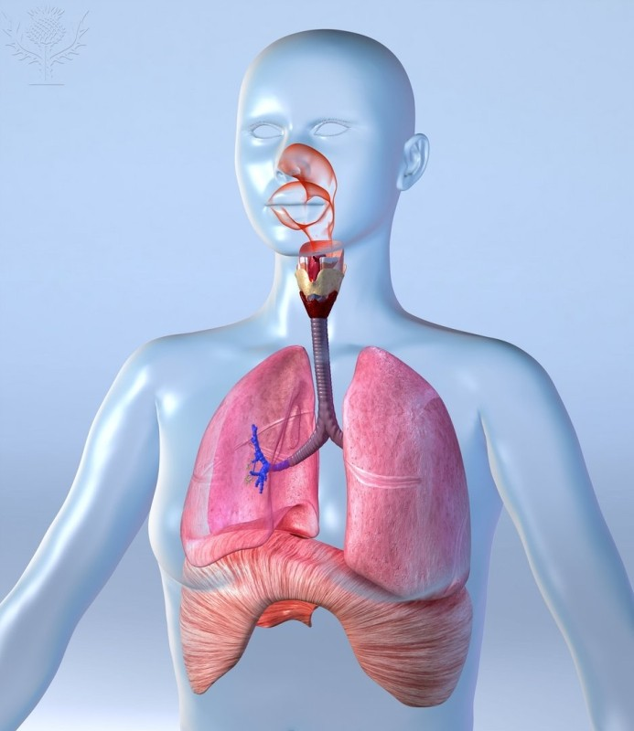
Citations
www.webMD.com
www.worldbookstudent.com
http://my.hrw.com/
http://www.innerbody.com/
www.wellstar.com
http://www.medtogo.com/Complete-Surgery-List.html
ROGER HARRIS / SCIENCE PHOTO LIBRARY / Universal Images Group
Rights Managed / For Education Use Only

