Slide 1
Microscope
Basics

Slide 2
The Compound Microscope
Compound Light Microscope
The compound light microscope is a common tool in a life science laboratory. A compound light microscope is an instrument that magnifies small objects so that they can be seen easily.

Slide 3
Compound Microscope Cont.
It has three main parts—a tube with two or more lenses, a stage, and a light. Items viewed through a compound microscope may be colored with special dyes to make them more visible. Items are placed on the stage so that the light passes through them. The lenses at each end of the tube magnify the image.

Slide 4
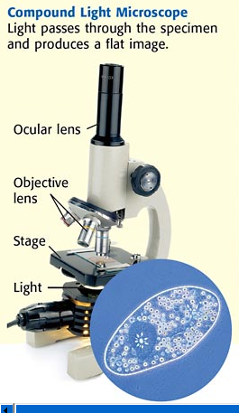

Slide 5
Parts Explained
The ocular lens magnifies the image 10x.
The low-power objective magnifies the
image 10x.
The high-power objective magnifies the
image either 40x or 43x.
The revolving nosepiece holds the objectives
and can be turned to change from one
magnification to the other.

Slide 6
The body tube maintains the correct
distance between the ocular lens and objectives.
The coarse-adjustment knob moves the body tube up and down to allow focusing of the image.
The fine-adjustment knob moves the body
tube slightly to bring the image into sharper
focus. It is usually located in the center of
the coarse-adjustment knob.
The stage supports a slide.
Stage clips hold the slide in place for viewing.

Slide 7
The diaphragm controls the amount of light coming through the stage.
The light source provides a light for viewing the slide.
The arm supports the body tube.
The base supports the microscope.

Slide 8
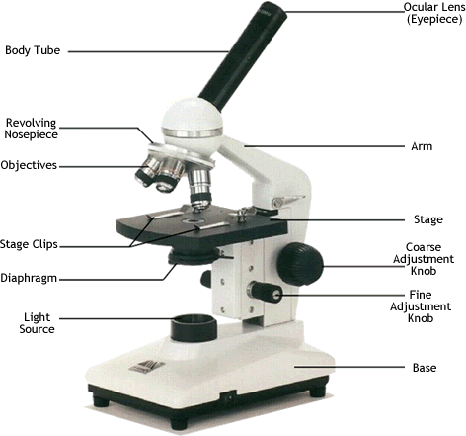
Ocular lens
(Eyepiece)
Body Tube
Nosepiece
Arm
Objectives
Stage
Stage Clips
Coarse Adjustment
Diaphragm
Fine Adjustment
Light
Base
Always carry a microscope with one hand holding the arm and one hand under the base.

Slide 9

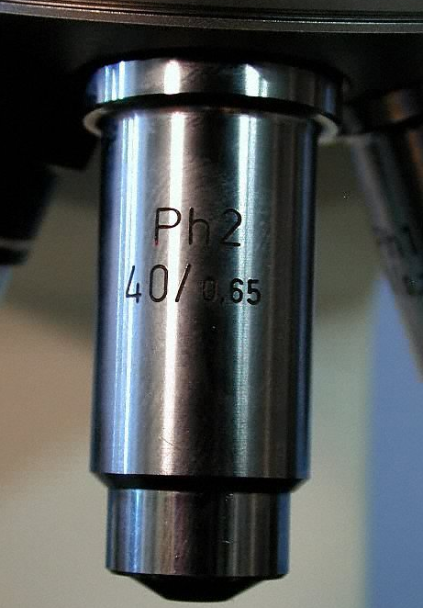
What’s my power?
To calculate the power of magnification, multiply the power of the ocular lens by the power of the objective.
10x40=400x

Slide 10

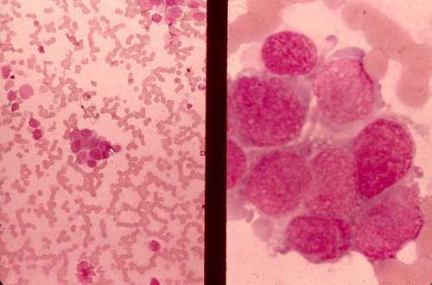
Comparing Powers of Magnification
We can see better details with higher the powers of magnification, but we cannot see as much of the image.
Which of these images would be viewed at a higher power of magnification?

Slide 11
How to make a wet-mount slide …
1 – Get a clean slide and coverslip from your teacher.
2 – Place ONE drop of water in the middle of the slide. Don’t use too much or the water will run off the edge and make a mess!
3 – Place the edge of the cover slip on one side of the water drop.
4 - Slowly lower the cover slip on top of the drop.
Cover Slip
Lower slowly
5 – Place the slide on the stage and view it first with the red-banded objective. Once you see the image, you can rotate the nosepiece to view the slide with the different objectives.
You do not need to use the stage clips when viewing wet-mount slides!

