Slide 1
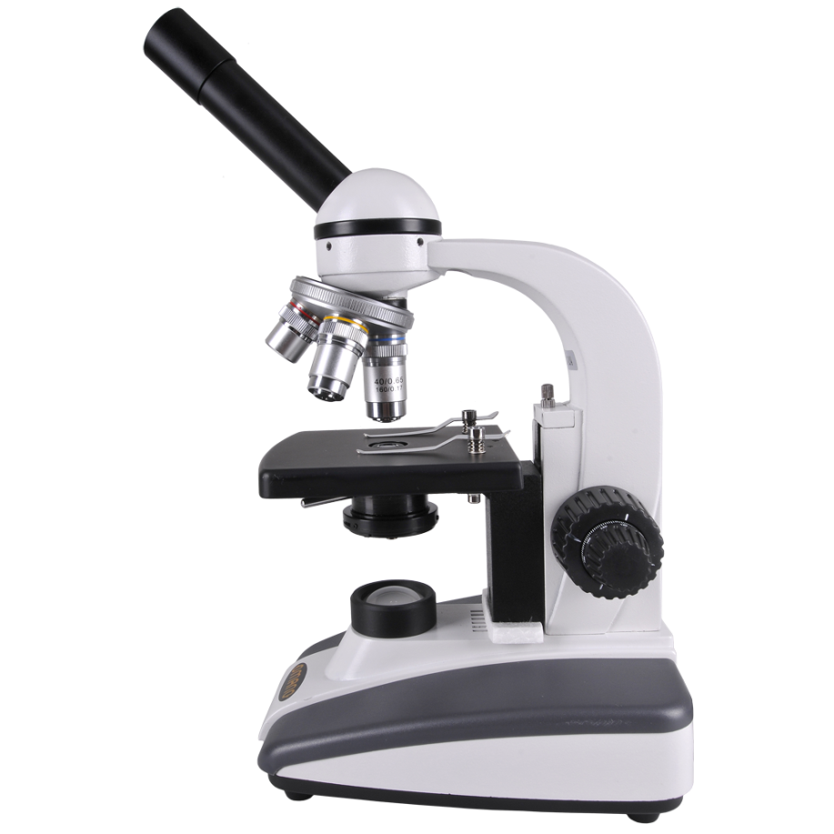
PARTS OF THE COMPOUND LIGHT MICROSCOPE
Ocular Lens / Eyepiece
A
magnify
Contains a lens to _______ the image of the specimen.
10
The usual magnification is ___ X.
The lens that we look through.

Slide 2
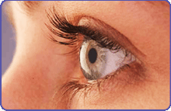
PARTS OF THE COMPOUND LIGHT MICROSCOPE
Body Tube
B
connects
It ________ the eyepiece to the objective lenses.
alignment
It ensures the correct ________ of the microscope components
to correctly _____ the light from the specimen into the viewer’s eye.
direct

Slide 3
PARTS OF THE COMPOUND LIGHT MICROSCOPE
Arm
C
connects
It ________ the body tube to the base.
hand
One ____ should be around the arm when _______ the microscope
carrying
(the other should be under the ____).
base

Slide 4
PARTS OF THE COMPOUND LIGHT MICROSCOPE
Arm
C
connects
It ________ the body tube to the base.
hand
One ____ should be around the arm when _______ the microscope
carrying
(the other should be under the ____).
base

Slide 5
PARTS OF THE COMPOUND LIGHT MICROSCOPE
Base
It ________ the weight of the microscope.
supports
electronics
light source
It contains the _________ and __________.
D
under
One hand should be _____ the base while _______ the microscope
carrying
(the other hand should be holding the arm).

Slide 6
PARTS OF THE COMPOUND LIGHT MICROSCOPE
Base
It ________ the weight of the microscope.
supports
electronics
light source
It contains the _________ and __________.
D
under
One hand should be _____ the base while _______ the microscope
carrying
(the other hand should be holding the arm).

Slide 7
PARTS OF THE COMPOUND LIGHT MICROSCOPE
Light Source / Illuminator
upwards
It sends light _______ through the _____________
condenser lens
hole
E
and through the ____ in the stage
specimen
onto the ________ on the slide.

Slide 8
PARTS OF THE COMPOUND LIGHT MICROSCOPE
Light Source / Illuminator
mirror
upwards
It sends light _______ through the _____________
condenser lens
hole
E
and through the ____ in the stage
specimen
onto the ________ on the slide.
mirrors
Older microscopes used to use ______ to ______ the ambient light upwards.
reflect

Slide 9
PARTS OF THE COMPOUND LIGHT MICROSCOPE
Revolving/Rotating Nose Piece
F
objective lenses
The _____________ are attached to it.
Rotating
_______ the nose piece allows you to _____ between the different lenses.
switch

Slide 10
PARTS OF THE COMPOUND LIGHT MICROSCOPE
Objective Lenses
Low (scanning)
4 X
Medium
10 X
G
High
40 X
magnify
These lenses further _______ the image of the specimen.
4 X
10 X
The magnifications are usually ___ , ____ and ____ .
40 X
3
There are usually __ lenses

Slide 11
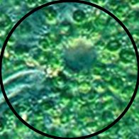
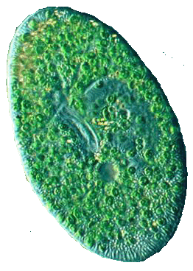
PARTS OF THE COMPOUND LIGHT MICROSCOPE
Objective Lenses
Low
Medium
High
G
As the power increases, the magnification becomes _____ ,
larger
but the field of view (visible area) becomes _______.
smaller

Slide 12
PARTS OF THE COMPOUND LIGHT MICROSCOPE
Coarse Adjustment Knob
H
first
The ____ knob you should use, and always under ___ power.
low
high
Never use it in ____ power.

Slide 13
PARTS OF THE COMPOUND LIGHT MICROSCOPE
Fine Adjustment Knob
H
I
first
The ____ knob you should use, and always under ___ power.
low
high
Never use it in ____ power.
second
The ______ knob you should use. Use under ______ power
higher
exact
for _____ focusing.
stage
Both knobs move the _____ up and down
focus
to help put the specimen in _____.

