Slide 1
Genetics and Heredity

Slide 2
Vocabulary
Genetics: the study of heredity.
Heredity: the passing of traits (physical characteristics) from parent to offspring

Slide 3
Vocabulary
Inheritance: how traits, or characteristics, are passed on from generation to generation.
Trait: a specific characteristic passed on to its offspring through DNA.

Slide 4
Vocabulary
Chromosomes are made up of genes, which are made up of DNA.
DNA: Genetic material found in the nucleus of a cell.
Gene: made up of DNA and code for specific traits.

Slide 5
Vocabulary
Dominant Gene: traits that are expressed and hides others.
Recessive Gene: traits that are covered up or only expressed when a dominant gene isn’t present.

Slide 6
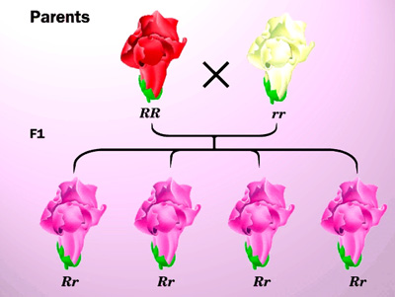
Vocabulary
Incomplete Dominance: each gene has its own degree of influence and produce a third trait.

Slide 7
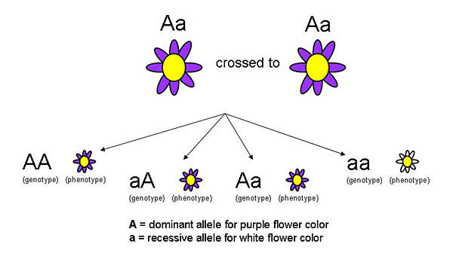
Vocabulary
Alleles- the different forms of a gene
Genotype- both inherited genes (alleles) together
Phenotype- an organisms appearance or other detectable characteristic

Slide 8
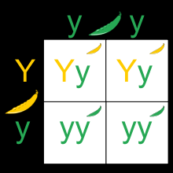
Vocabulary
Punnett Squares- tool used to predict traits in an offspring. Letters are used to designate genes. Capital letters for dominant and lower case for recessive.
Probability- the chance/percentage that something will occur.

Slide 9
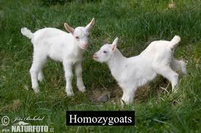
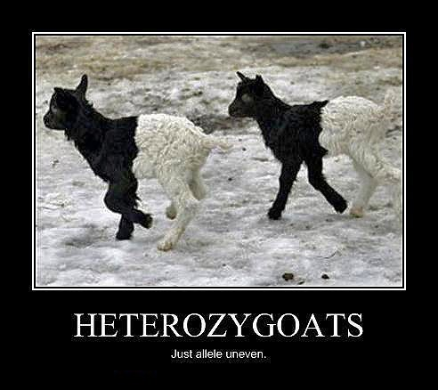
Vocabulary
Homozygous- two of the same genes (alleles)
Heterozygous- two different genes (alleles)

Slide 10
Gregor Mendel
Considered “The Father of Genetics”
Austrian Monk
Experimented with “pea plants”
Used pea plants because:
They were available
They reproduced quickly
They showed obvious differences in the traits
Understood that there was something that carried traits from one generation to the next- “FACTOR”.

Slide 11
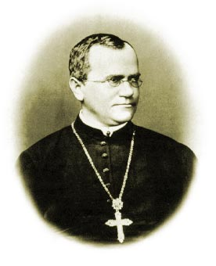
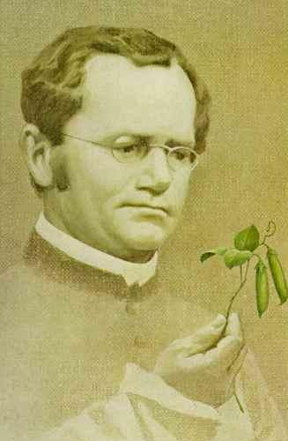
Mendel cont……
In the mid-1800s, the rules underlying patterns of inheritance were uncovered in a series of experiments performed by an Austrian monk named Gregor Mendel.

Slide 12
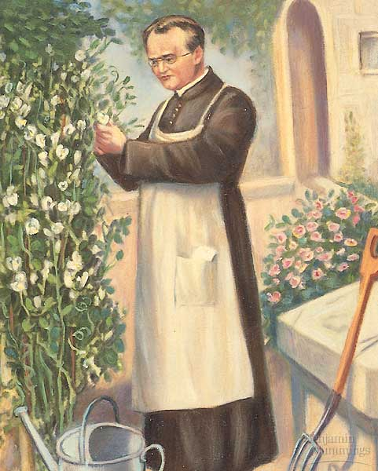
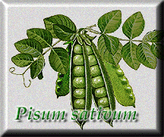
Mendel's Plant Breeding Experiments
Gregor Mendel was one of the first to apply an experimental approach to the question of inheritance.
For seven years, Mendel bred pea plants and recorded inheritance patterns in the offspring.
Hypothesis of Inheritance
Parents pass on to their offspring separate and distinct factors (today called genes) that are responsible for inherited traits.

Slide 13
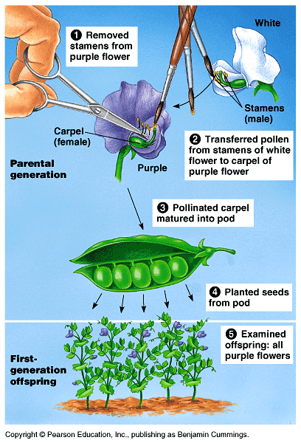
Mendel was fortunate he chose the Garden Pea
Mendel probably chose to work with peas because they are available in many varieties.
The use of peas also gave Mendel strict control over which plants mated.
Fortunately, the pea traits are distinct and were clearly contrasting.

Slide 14
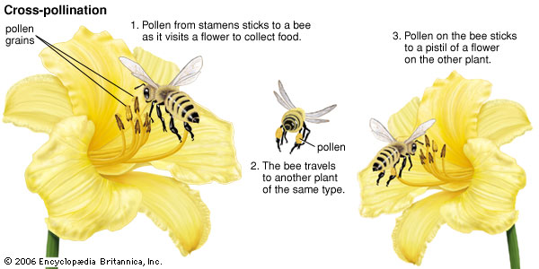
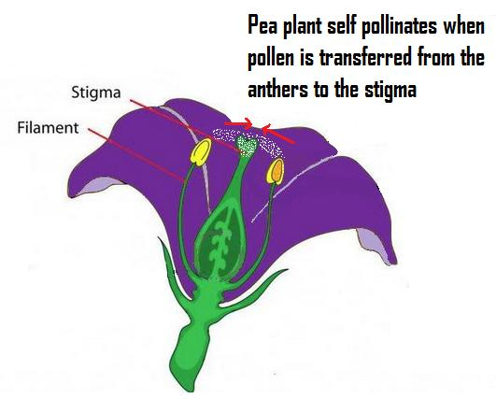
Vocabulary
Cross-Pollination: when pollen from a plant is transferred to a flower on a different plant.
Self-Pollination: when pollen from a plant is transferred to a flower on the same plant.

Slide 15
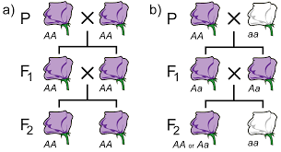
Vocabulary
True-Breeding (Purebred): an organism created by two of the same breed.
Hybrid: an organism created by two different breeds.

Slide 16
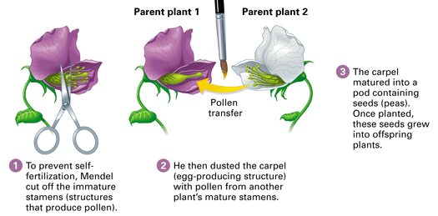
To test the hypothesis, Mendel crossed true-breeding plants that had two distinct and contrasting traits—for example, purple or white flowers.
What is meant by “true breeding?”
Mendel cross-fertilized his plants by hand. Why is it important to control which plants would serve as the parents?

Slide 17
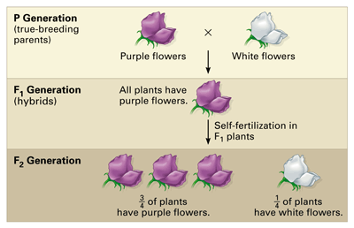
For each monohybrid cross, Mendel cross-fertilized true-breeding plants that were different in just one character—in this case, flower color. He then allowed the hybrids (the F1 generation) to self-fertilize.

Slide 18
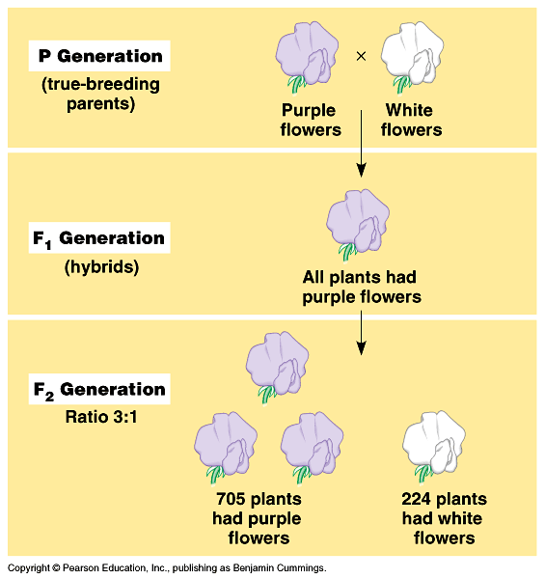
P generation (parental generation)
F1 generation (first filial generation, the word filial from the Latin word for "son") are the hybrid offspring.
Allowing these F1 hybrids to self-pollinate produces:
F2 generation (second filial generation).
Typical breeding experiment

Slide 19
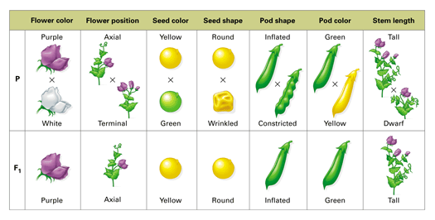
Mendel studies seven characteristics in the garden pea

Slide 20
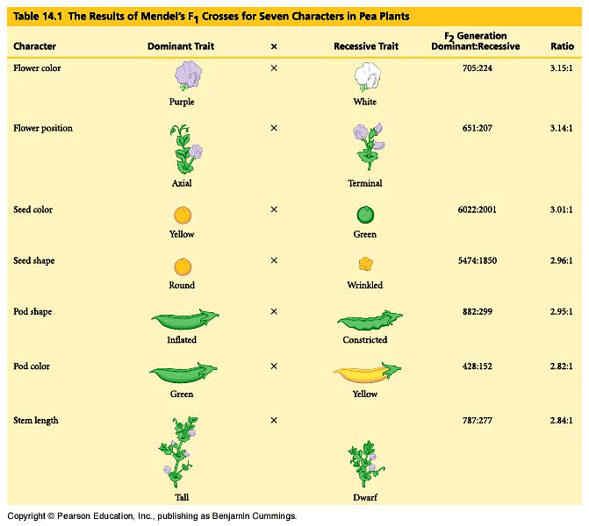
:
Statistics indicated a pattern.

Slide 21
Law of Dominance
In the monohybrid cross (mating of two organisms that differ in only one character), one version disappeared.
What happens when the F1’s are crossed?

Slide 22
The F1 crossed produced the F2 generation and the lost trait appeared with predictable ratios.
This led to the formulation of the current model of inheritance.

Slide 23
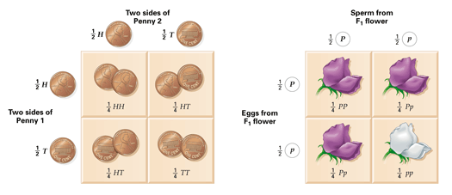
Probability and Punnett Squares
Punnett square: diagram showing the probabilities of the possible outcomes of a genetic cross

Slide 24
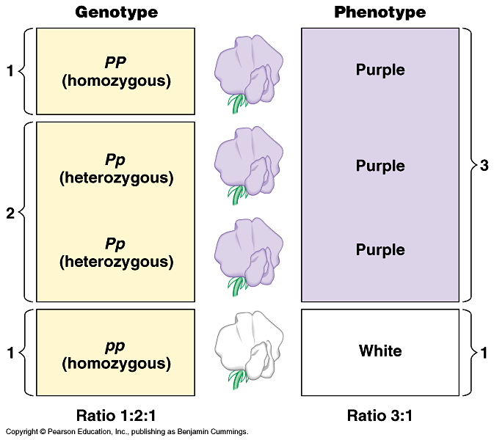
Genotype versus phenotype.
How does a genotype ratio differ from the phenotype ratio?

Slide 25
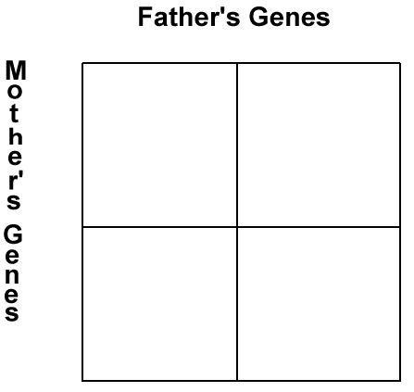
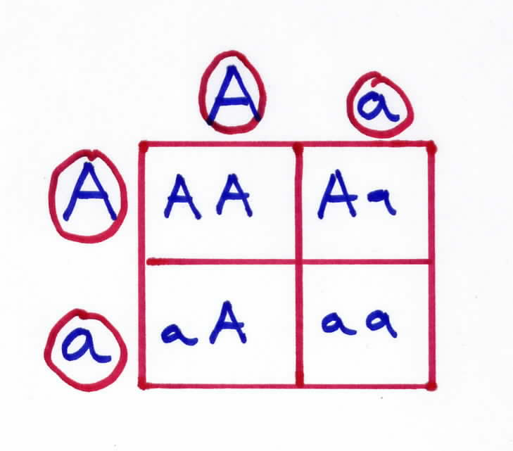
How Does it Work?

Slide 26
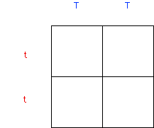

Slide 27
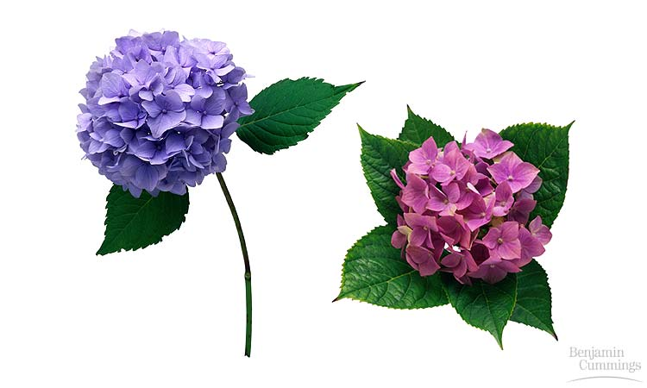
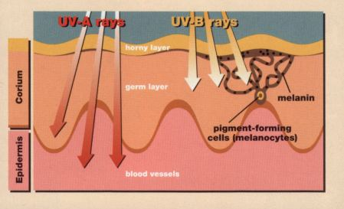
The Importance of the Environment
The environmental influences the expression of the genotype so the phenotype is altered.
Hydrangea flowers of the same genetic variety range in color from blue-violet to pink, depending on the acidity of the soil.
Multifactorial; many factors, both genetic and environmental, collectively influence phenotype in examples such as skin tanning

