Slide 1
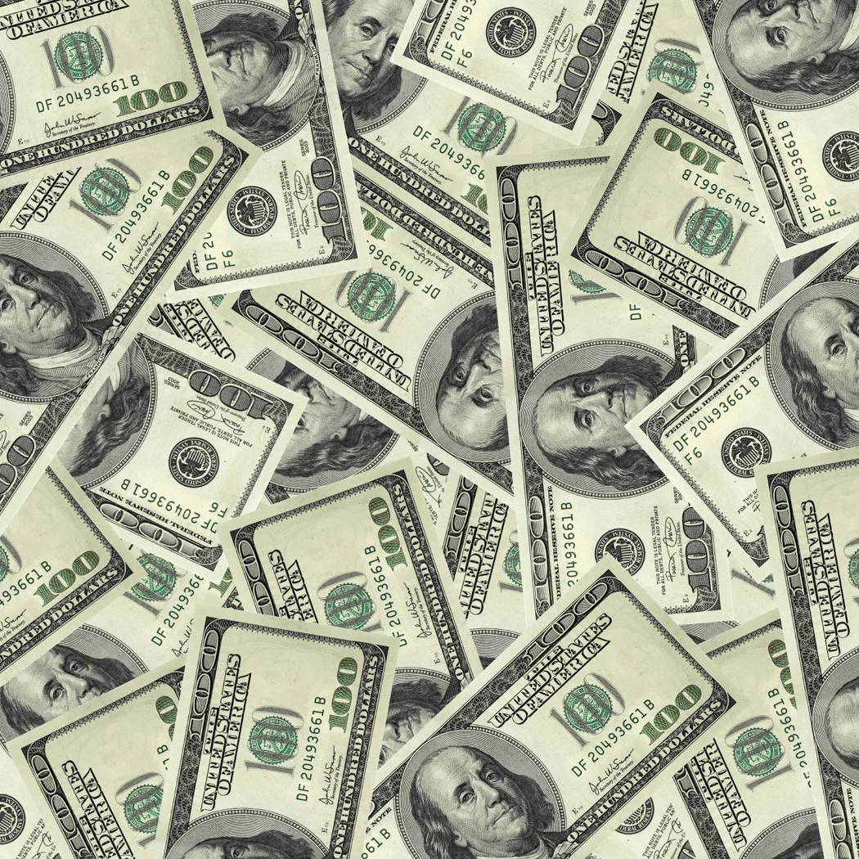
Economics
How many basic types of economic systems are there?
Name the economic systems.
Which economic system do most textbooks say is the most common throughout the world?

Slide 2
Economics
How many basic types of economic systems are there? 3
Name the economic systems. Traditional, Command, Market
Which economic system do most textbooks say is the most common throughout the world? Mixed. The GCEE states that mixed is not an economic system but rather a blending of two different types of systems.

Slide 3
Economic System
Explains how a country answers the three questions of economics:
1) What to produce?
2) For whom to produce?
3) How to produce?
Traditional
Market
MIXED
Command

Slide 4
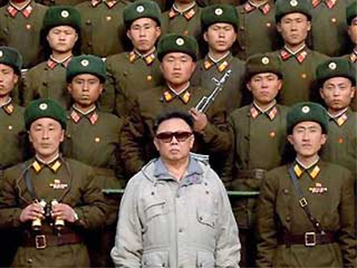
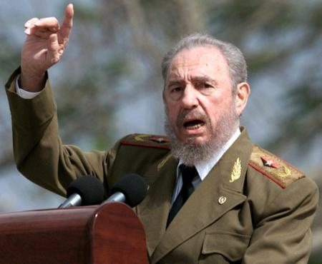
Command Economy
Government decides what is produced, who receives goods and services, and how things are produced
Examples: North Korea and Cuba are close to pure command economies

Slide 5
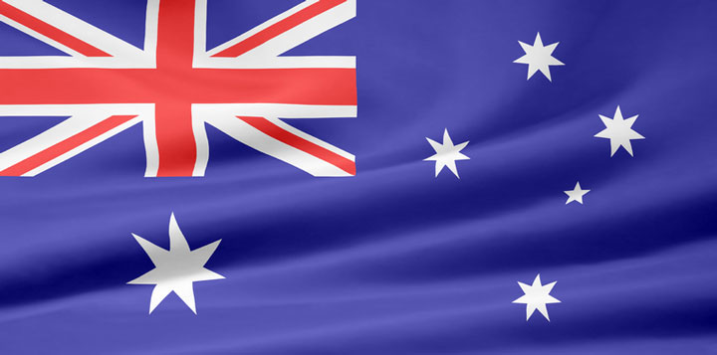
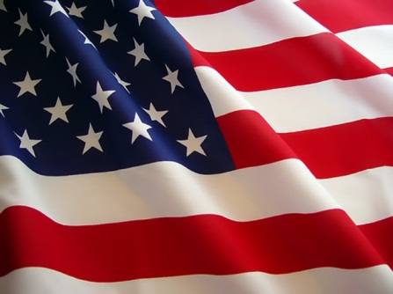
Market Economy
Consumers and producers determine what’s produced, who receives goods/services, and how things are produced (supply & demand)
Also called “capitalism” or “free market”
Encourages entrepreneurs (creators of new businesses)

Slide 6
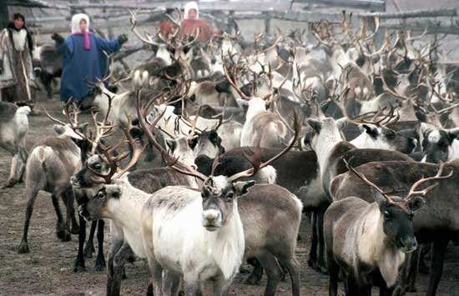
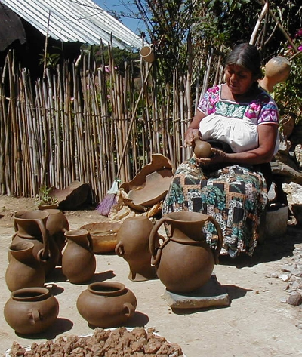
Traditional Economy
Economic decisions are based on a country’s or society’s customs and habits
Old ways of doing things—hunting or farming
Not common

Slide 7
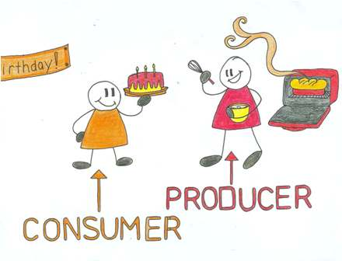
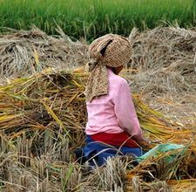
Mixed Economy
When a country combines elements of market and command systems (and sometimes traditional elements as well)
Most societies fall under this category, including ours!

Slide 8
Economic Systems
Pure
Command
Pure
Market
Mixed Economy

Slide 9
Economic Systems
United Kingdom
79%
Germany
71%
Russia
51%
0
100
Pure
Command
Pure
Market
Mixed Economy
Notes:
6th Grade- This information is meant to be used in conjunction with the 6th and 7th grade Teacher Notes. For additional resources, go to GeorgiaStandards.org. (Note: This is not an expectation for students to memorize numbers, but to understand that factors that influence specific countries to move more towards a command or market economy). The numbering system is based on The Heritage Foundation’s Economic Freedom Index 2009 The Heritage Foundation is a conservative organization that has partnered with the Wall Street Journal for over a decade to evaluate each country based on a set of 10 criteria to determine economic freedom. Update information using resources listed in the Teacher Notes.

